Slide 1
Extend Power Apps Portals

Slide 2
What is Microsoft Dataverse?
Note
Effective November 2020:
Common Data Service has been renamed to Microsoft Dataverse. Learn more
Some terminology in Microsoft Dataverse has been updated. For example, entity is now table and field is now column. Learn more

Slide 3

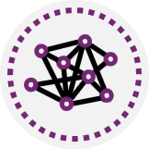
Module agenda
Introduction to Power Apps portals
Access Common Data Service in Power Apps portals
Extend Power Apps portals
Build custom Power Apps portals web templates

Slide 4
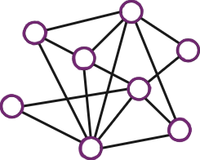
Introduction to Power Apps portals

Slide 5
Power Apps portals and what they can do for you
Modern audience:
By using Power Apps portals, you can provide them with a branded, personalized, self-service experience.
Portals help you provide an organized, searchable knowledge
Portals provide simple navigation with seamless transitions between self and assisted support.
Modern business:
Provide self-service support
Build a sales pipeline
Empower employees
Engage mobile workforce
Power Apps portals capabilities:
Power Apps portals are built on top of Common Data Service.
Power Apps portals deliver a complete content management system out of the box, with all content stored in Common Data Service.
Notes:
Modern audience
Out-of-the-box mobile optimizations for portal and knowledge articles ensure that customers can get the help that they need, any time and from any device.
The majority of global consumers now expect brands and organizations to offer a self-service portal.
Nearly one-third of consumers keep in touch with brands they've done business with to make sure that they are getting the most out of their purchase.
Half of the consumers are using multiple channels to stay connected, including web, mobile, telephone, social, and self-service channels. Often, consumers use many channels for a single support experience.
Modern business
Provide self-service support - When your business is growing, rather than having to employ extra staff in call centers, you could use Power Apps portals to add self-service capabilities to your website so that your customers can search knowledge articles, engage with other customers, find answers, and create support cases when needed (that go directly into Dynamics 365 Customer Service), all without a single interaction from your resources.
Build a sales pipeline - When a lead fills out a Contact Us form on your company website, this information is recorded in Dynamics 365 Sales where the record can become part of your sales pipeline automatically.
Empower employees - When an employee needs a new computer, they can fill out an online form, where the information will be recorded in Common Data Service so the helpdesk staff can immediately access and process this information.
Engage mobile workforce - Empower agents on any device, wherever they work. Field technicians can process and complete work orders in the field, instantly updating Dynamics 365 Field Service.
Power Apps portals capabilities
Power Apps portals are built on top of Common Data Service. This architecture comes with a major benefit. All the differentiating features of model-driven Power Apps are the features of Power Apps portals as well, including:
Centralized management
Common Data Model
Roles and permissions
Forms and views
Business rules
Declarative workflows and actions
Plug-in architecture
Integration with other services
Common Data Service extensibility
Audit

Slide 6

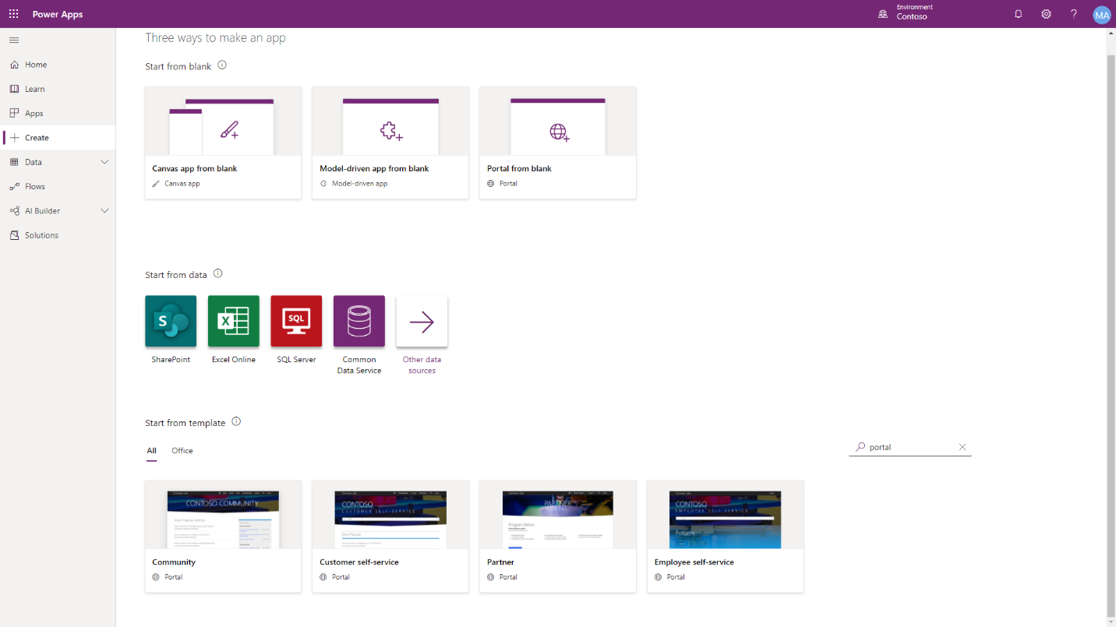
Get started with portals
Portal templates:
If you are building a custom business application by using Common Data Service without Dynamics 365 apps enabled, your only choice is the Portal from blank option.
If you are using Microsoft Dynamics 365 apps，you have a choice of five additional portal templates
Provision a portal
Only one Power Apps portals can be provisioned for each Common Data Service environment
Notes:
A Power Apps portal is not automatically provisioned when a new Common Data Service environment is created. You will need to provision a Power Apps portal and determine the name, default URL, language, and template.
If you are using Microsoft Dynamics 365 apps such as Dynamics 365 Sales or Dynamics 365 Service, you have a choice of five additional portal templates:
Community portal
Customer self-service portal
Employee self-service portal
Partner portal
Customer portal (Dynamics 365 Supply Chain Management)
The high-level steps to provision a starter portal are:
Go to https://make.powerapps.com .
Select a target environment.
On the left menu, select + Create, Select Portal from blank.
Provide a name and a unique address (URL) for the portal.
Select the language.
Select Create.

Slide 7
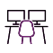
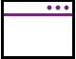



Overview of core components of portals
Power Apps portals Studio
Webpages
Page templates
Content snippets
Entity lists and entity forms
Notes:
The next slides will go into detail on portals studio, content snippets, and entity lists + forms. Give a high level at this time.

Slide 8
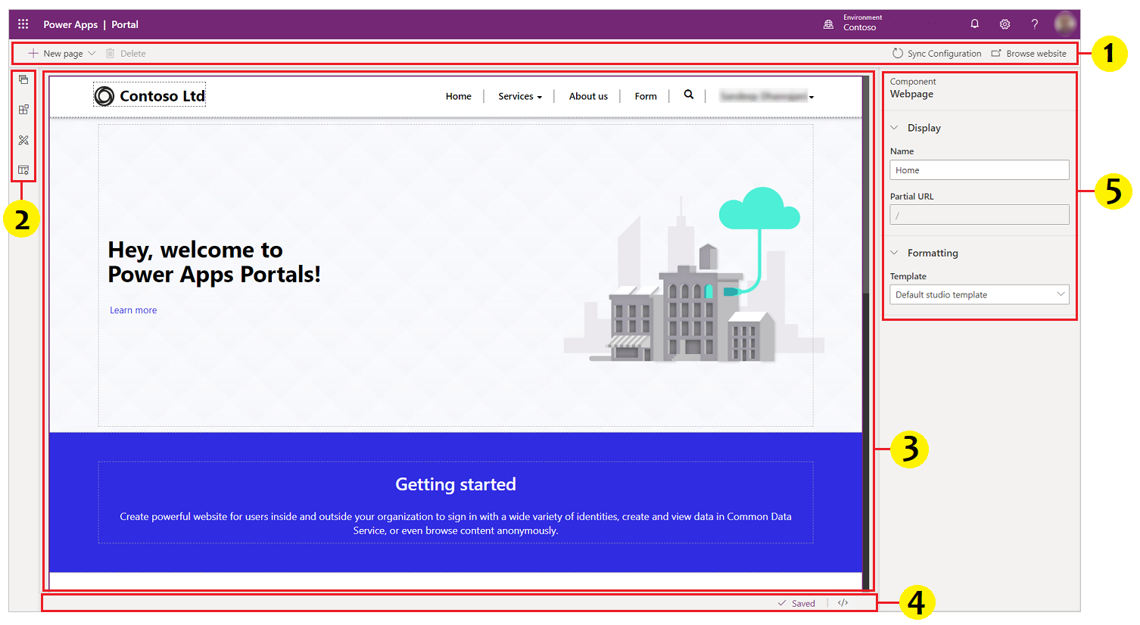
Power Apps portals Studio
Power Apps portals Studio components:
Command bar – Allows you to:
Create a webpage.
Delete a component.
Sync Configuration
Toolbelt – Allows you to:
View and manage webpages
Add components
Edit templates
Canvas
Footer
Properties pane

Slide 9
Web pages and page templates
Webpages
A webpage is a document that is identified by a unique URL in a website. Through parent and child relationships to other webpages, webpages form the hierarchy of a website, that is, its site map.
Page templates
A webpage record is linked to a Page template record that defines the layout and the behavior. Think of the webpage as the exact URL and the Page template as the blueprint for displaying the content.
Notes:
Webpages can be added and edited by using the Portal Studio, the portal front-side editor, or directly in Common Data Service by using the Portal Management app.

Slide 10
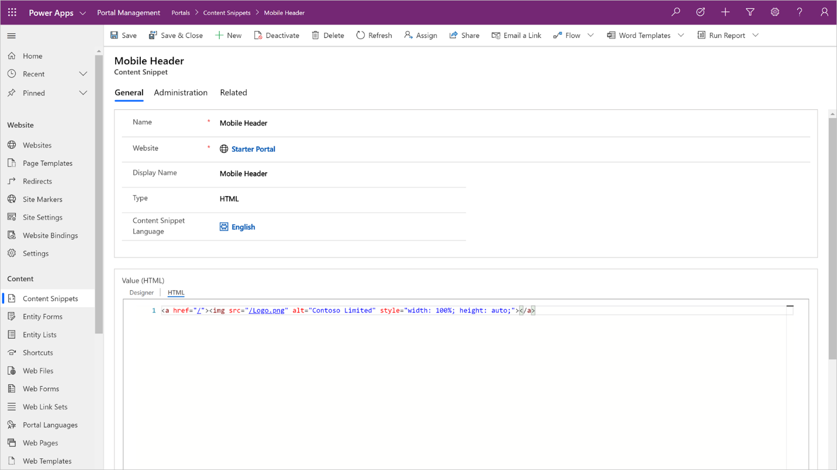
Content snippets
Content snippets include:
Plain text
HTML layout
Template processing instructions
Mobile Header is a content snippet that can be updated with your company’s logo to quickly and easily tailor the portal to your needs.
Snippets can be edited by using Portal Studio and Common Data Service records by using the Portal Management app.

Slide 11
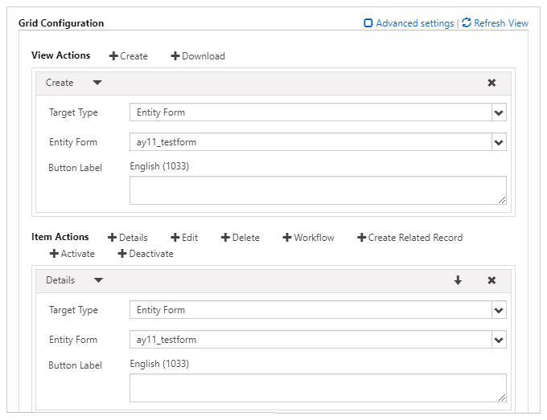
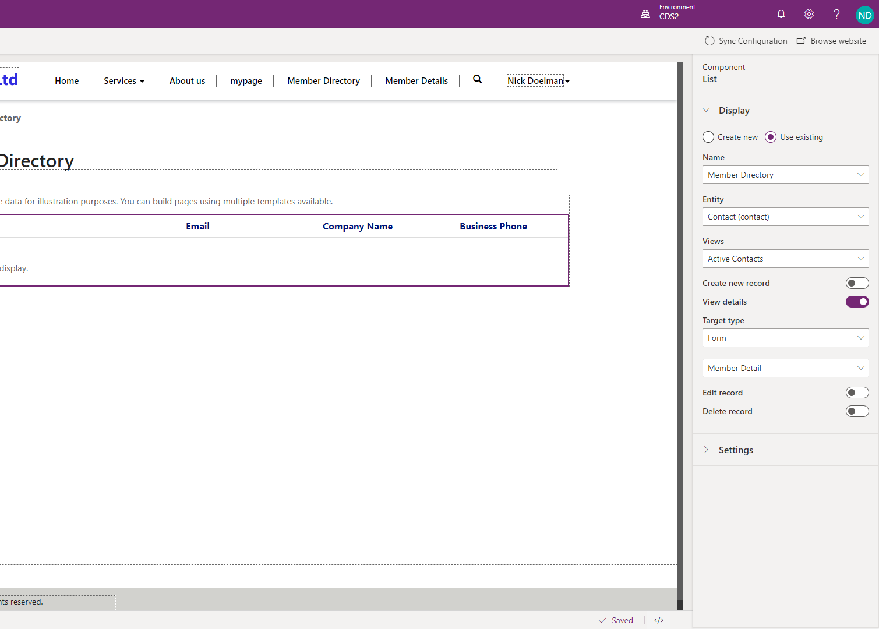
Entity lists and entity forms
Notes:
The strength of Power Apps portals is the ability to interact with information and data that is stored in Common Data Service. Entity lists and entity forms are used in Power Apps portals to define what data should render on the portal from Common Data Service, such as a list of records from an entity or a form to capture and display data for a specific record.
A webpage record can be linked to an entity list or an entity form. The linked list or form will be used by the template to render the page layout with data from Common Data Service, such as a list of all Active Contacts to form the above Member Directory list. In the Properties pane on the right of the above example, you see that this entity list was created to display the Active Contacts view from the contacts entity.
Entity lists can include functionality like filtering and sorting and can also have actions associated with them to enable Create/Edit/Read abilities and to trigger workflows. With this, App Makers can determine what will happen when a user opens a record from a list, such as taking them to a form displaying the details of the selected record.

Slide 12
Using themes in portals
Enable basic theme:
Enable basic theme feature is set to Off as default
When you turn on this feature, you can use default themes called Presets.
You can also create copies of the preset themes for additional customization.
Change theme for your portal:
You can set any existing theme in your portal to the default theme.
Create a new theme & Edit theme details:
You can create a new theme by clicking the New theme button
You can update theme name, description, color, and other typography settings in Power Apps Studio.
Notes:
The steps of creating copies of the preset themes for additional customization:
Sign in to Power Apps by navigating to make.powerapps.com
Select Apps from the left navigation pane, and then select your portal.
Set any existing theme:
Sign in to Power Apps by navigating to make.powerapps.com
Select Apps from the left navigation pane, and then select your portal.
Select More Commands (...), and then select Edit.
Select Theme from the components pane.
Create a new theme
Sign in to Power Apps by navigating to make.powerapps.com
Select Apps from the left navigation pane, and then select your portal.
Select More Commands (...), and then select Edit.
Select Theme from the components pane.
Select New Theme.
Edit theme details:
Sign in to Power Apps by navigating to make.powerapps.com
Select Apps from the left navigation pane, and then select your portal.
Select More Commands (...), and then select Edit.
Select Theme from the components pane.
Select the theme that's currently applied or select a new theme from the presets. Selecting a theme opens the details pane on the right side of your workspace.
Edit theme details such as name, description, and color for different areas.
Save and publish the changes.

Slide 13
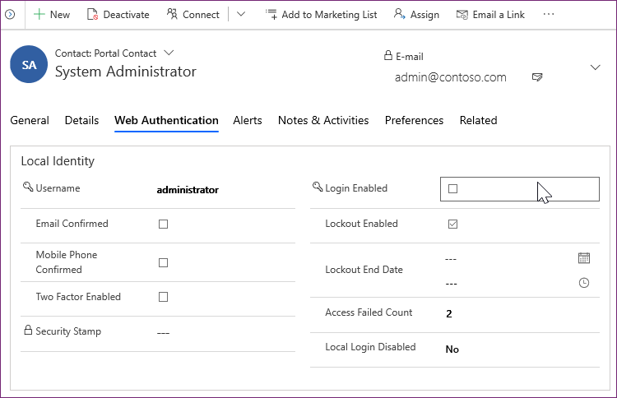
Overview of portals security
The Portal Management model-driven app provides access to the contact entity and has forms to:
Manage passwords
View portal-specific contact information
Provide registration and profile management forms for the portal.
Authentication:
Local authentication
External authentication
Authorization
Notes:
More detail on next slides

Slide 14
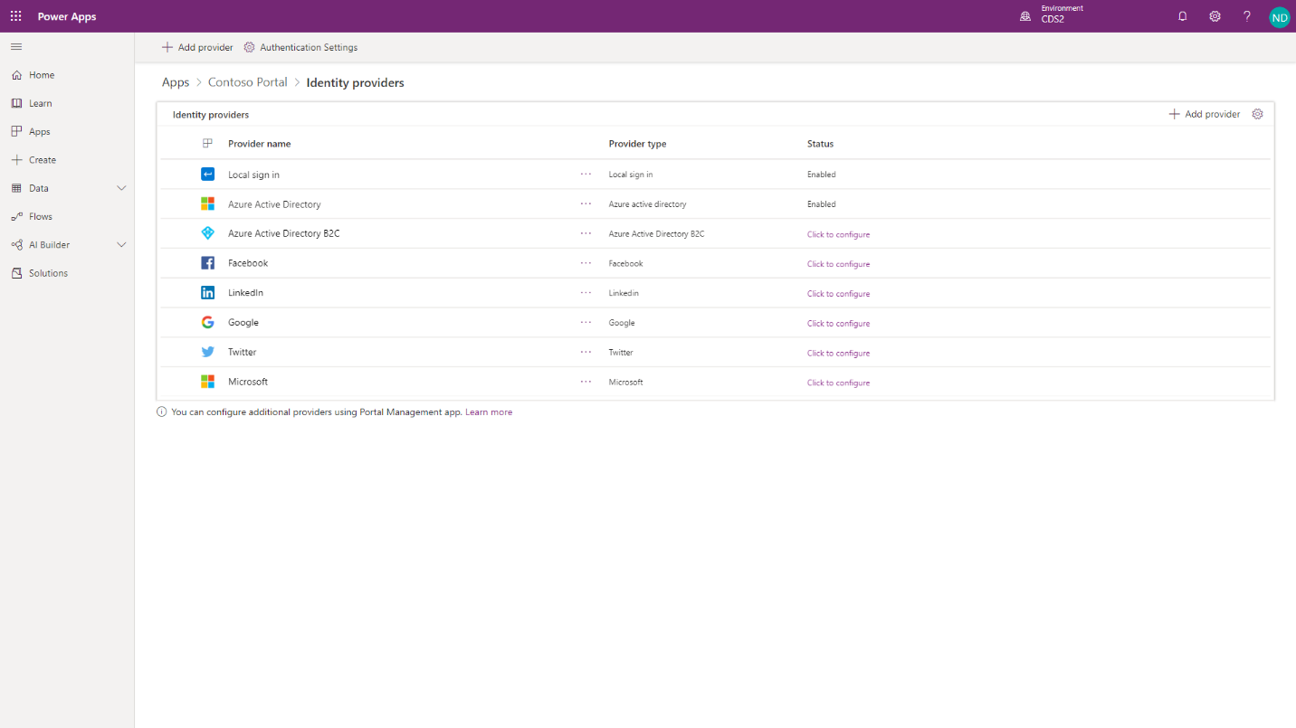
Authentication
Notes:
Portal users can authenticate by using the following methods:
Local authentication - Basic authentication with usernames and passwords are stored in the Common Data Service contact record internally.
External authentication - Credentials and password management are handled by other identity providers. Supported authentication providers include:
OAuth2 (Microsoft, Twitter, Facebook, Google, LinkedIn, Yahoo)
Open ID (Azure Active Directory, Azure Active Directory B2C)
WS-Federation and SAML 2.0 (used for integration with on-premises Active Directory and other identity services)
Portal administrators can choose to enable or disable any combination of authentication options through portal Authentication Settings.
IMPORTANT: AZURE Active Directory B2C is the recommended identity provider for authentication. If another provider support is required, then it can be configured in Azure Active Directory B2C.

Slide 15
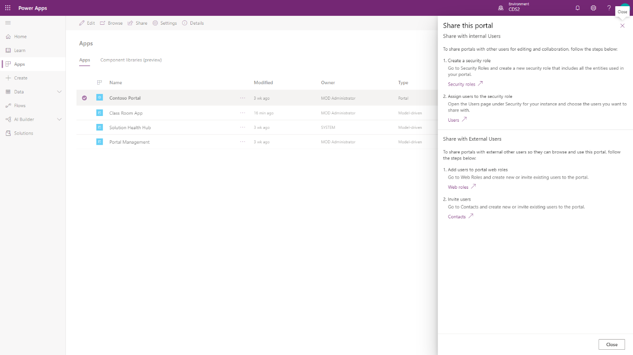
Authorization
Notes:
After the user is authenticated and associated with a contact, Power Apps portals use numerous entities to define authorization, that is, what a user is allowed to do. Selecting Share from the portal app options will provide information on how to share the portal app with internal and external users.

Slide 16
Web roles
Web roles allow an administrator to control user access to portal content and Common Data Service records.
A web role can be associated with the following records:
Website permissions - Define what (if any) front-side editing permissions that a web role should have.
Webpage access rules - Define what pages are visible to a web role and what actions can be taken.
Entity permissions - Define what access a web role has to individual Common Data Service entities.
Web Role
Website
Permissions
Web Page Access Rules
Entity Permissions
Notes:
A portal contact might be assigned to one or more web roles at a time. Access rules and permissions of individual roles are combined to determine the resulting permissions set.
One of the web roles in the portal can be marked as Anonymous and all of the others are Authenticated. These roles allow you to apply permissions and access rules to all portal users based on whether they are signed in. If a user is not signed in, they will view the portal with the Anonymous web role permissions, which should be the most restrictive permissions.

Slide 17
Access Common Data Service in Power Apps portals

Slide 18
Introduction
A typical use case of Microsoft Power Apps portals is to extend functionality from Dynamics 365 applications to internal and external audiences.
You have extended case management features of Dynamics 365 Customer Service. Your app now handles product warranties, return management authorization (RMA), refunds, and product replacements. You can extend the Customer self-service portal to bring this functionality to your customers, allowing them to register the warranty, make a claim, fill in an RMA form directly on the site, and so on.
You have built an application in Common Data Service to track charitable donations, from both individual and corporate donors, and fundraising campaigns. You can build a portal to allow individuals to donate online and for employers to view and match their employees' donations.
You use Common Data Service to track the progress of your certification programs from the application process, to the evaluation of various skill assessments, to awarding a certification level to a candidate. A Power Apps portal can be configured to allow online applications, provide access to update evaluations, and allow candidates to view their progress.
Notes:
A typical use case of Microsoft Power Apps portals is to extend functionality from Dynamics 365 applications to internal and external audiences. The portal templates that are based on Dynamics 365 apps offer built-in functionality to these audiences by adding features like case life cycle, knowledge article access, partner opportunity management, and so on.
Additionally, Power Apps portals can extend applications that are built on Common Data Service and then display the data and business logic and make them available on your portal to an external audience, based on user permissions.
Consider the following scenarios:
You have extended case management features of Dynamics 365 Customer Service. Your app now handles product warranties, return management authorization (RMA), refunds, and product replacements. You can extend the Customer self-service portal to bring this functionality to your customers, allowing them to register the warranty, make a claim, fill in an RMA form directly on the site, and so on.
You have built an application in Common Data Service to track charitable donations, from both individual and corporate donors, and fundraising campaigns. You can build a portal to allow individuals to donate online and for employers to view and match their employees' donations.
You use Common Data Service to track the progress of your certification programs from the application process, to the evaluation of various skill assessments, to awarding a certification level to a candidate. A Power Apps portal can be configured to allow online applications, provide access to update evaluations, and allow candidates to view their progress.
[!NOTE] A Power Apps portal can only access Common Data Service data in the same instance where the portal is provisioned. Connecting to multiple instances and accessing data across the instances or across the tenants is not supported.
Model-driven Power Apps are low-code/no-code methods that you can use to build unique line-of-business applications (see What are model-driven apps in Power Apps?). Part of the app creation process is to define the model and UI elements such as views and forms (see Understand model-driven app components). Power Apps portals extends these UI elements to the web by using entity lists, entity forms, and web forms:
Entity lists - Define how the list of Common Data Service records is displayed on the portal pages. They are defined by one or more model-driven app entity views and include functionality like filtering and sorting.
Entity forms - Add the ability for the portal pages to interact with the records in a specific entity by using a model-driven app form definition as a layout template.
Web forms - Render one or more model-driven app forms on a portal website with support for single or multi-step navigation and conditional branching logic.
Lists and forms in Model-Driven Apps and Portal

Slide 19
Use entity lists to display multiple Common Data Service records
The Entity Lists component allows a maker to display a list of Common Data Service records on a portal webpage by using configuration only.
Notes:
The Entity Lists component allows a maker to display a list of Common Data Service records on a portal webpage by using configuration only. Entity lists are defined by using model-driven app views and can be further configured to filter data based on entity permissions. Entity lists can have additional features enabled such as running workflows and navigating to show detail records.

Slide 20
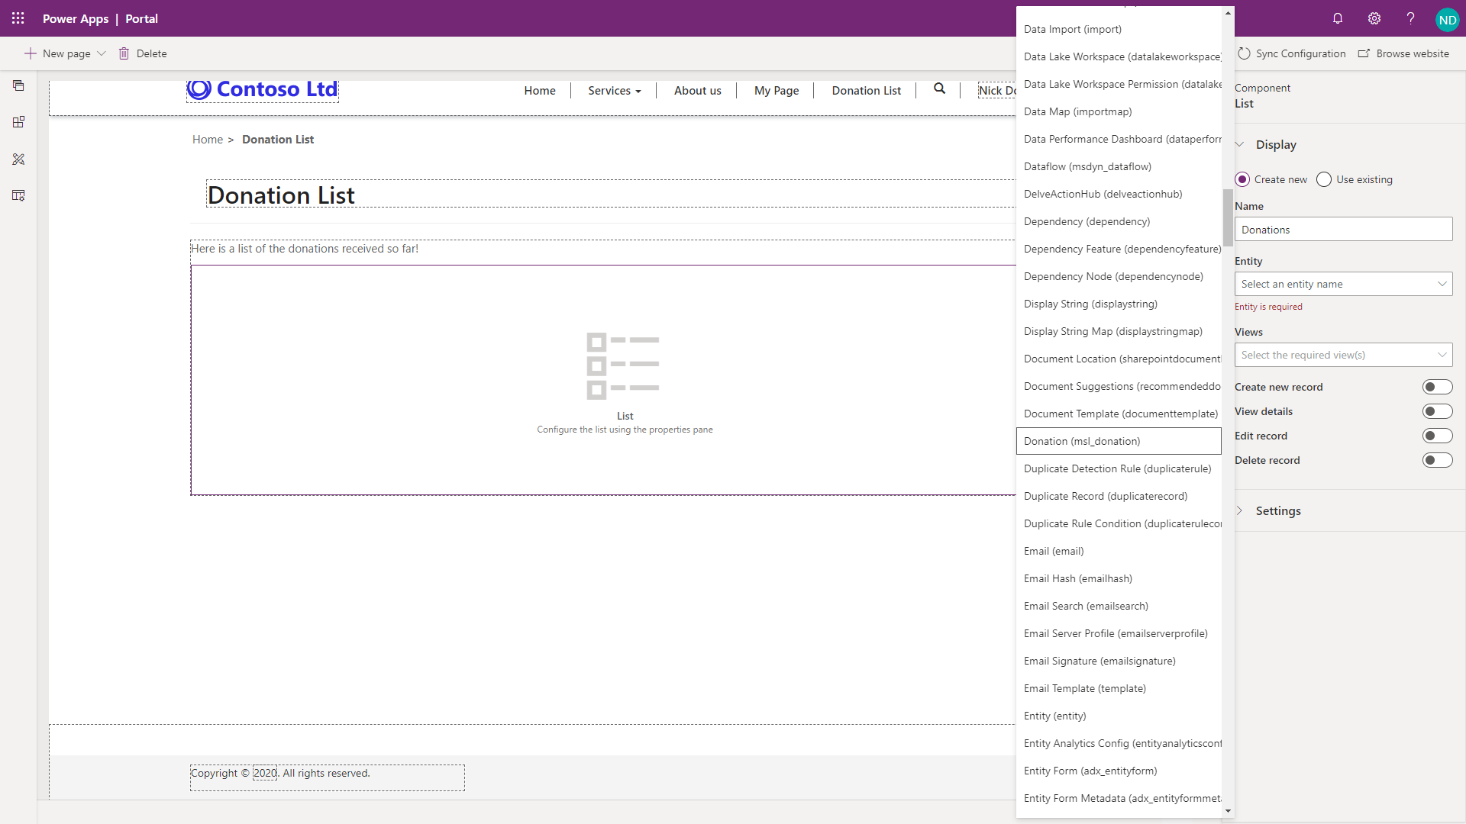
Create an entity list
An entity list can be added as a component to a webpage in Power Apps portals Studio.
Notes:
An entity list can be added as a component to a webpage in Power Apps portals Studio. After placing the list component on a page, the maker will need to set the properties of the entity list. Then, the maker will choose the entity and one or more model-driven views to be used to render the entity list on the page.
Adding entity list in Portal Studio

Slide 21
List rendering
Adding a list component in portals Studio will add the corresponding Liquid tag to the webpage content.
Text
{% include 'entity_list' key: '<<Entity List Name>>' %}
Notes:
Adding a list component in portals Studio will add the corresponding Liquid tag to the webpage content.
When the webpage is requested, the list rendering process is as follows:
The webpage is retrieved.
The webpage will render the entity list based on the Liquid tag that was added when the list component was added to a webpage.
{% include 'entity_list' key: '<<Entity List Name>>' %}
{% include 'entity_list' key: '<<Entity List Name>>' %}

Slide 22
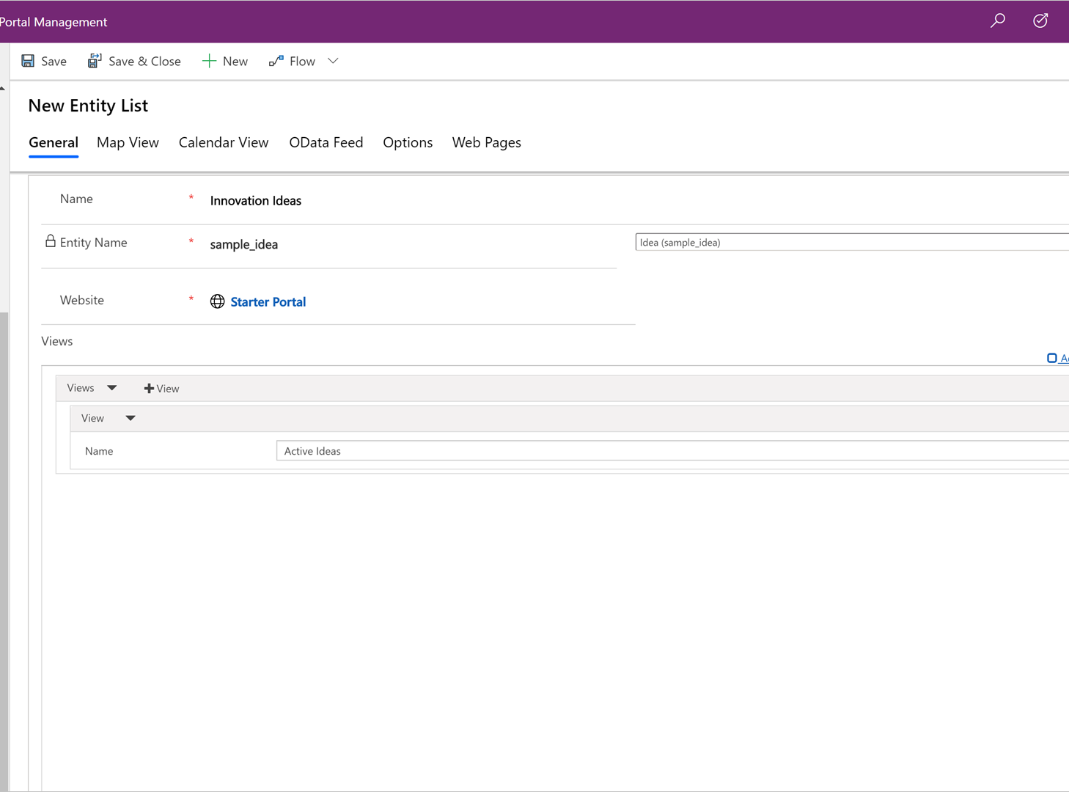
Configure the entity list
Power Apps portals Studio provides a basic interface for creating and configuring an entity list.
Notes:
Demo

Slide 23
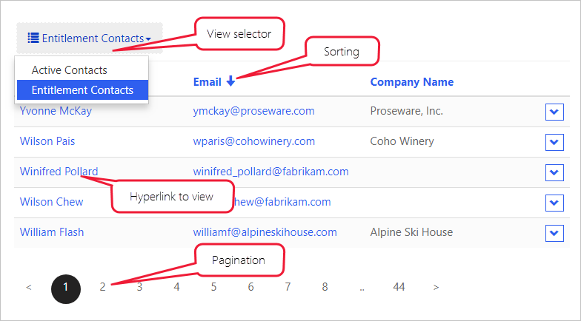
Views
Selected view(s) define the Common Data Service entity fields, list layout, and the default sort order.
Sorting and pagination - Sorting is enabled on any of the displayed columns and the page size is configurable.
Multiple views - If more than one view has been specified, a drop-down list will be rendered to allow the user to switch between the views.
Notes:
Selected view(s) define the Common Data Service entity fields, list layout, and the default sort order.
Multiple views - If more than one view has been specified, a drop-down list will be rendered to allow the user to switch between the views.
Sorting and pagination - Sorting is enabled on any of the displayed columns and the page size is configurable.
Entity list features
[!NOTE] Entity lists include the Web Page for Details View and Web Page for Create general properties. These properties are for backward compatibility only. The functionality is included as part of the View Actions and Item Actions grid configuration.

Slide 24
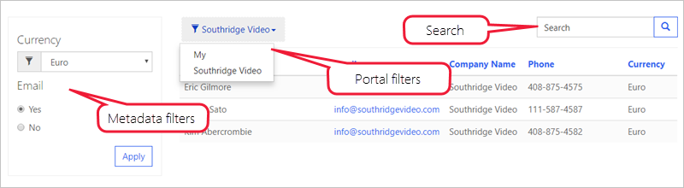
Configuration – filter and search
Notes:
The following sections describe the different types of configuration that are available in entity lists.
Entity lists provide you with several options to filter and search list data:
Search - When quick search is enabled, the portal will render a text search box. It is similar to the quick search feature in model-driven apps. Quick search runs across the view columns and allows you to locate the information within the larger lists by using plain text input. Portal users can use the asterisk wildcard character to search on partial text.
Portal filters - The list data can be filtered by the current portal user, the current portal user's parent account, and the current portal website. This feature enables some common scenarios without needing additional configuration:
List of product reviews that are left by the current user
List of campus buildings for the current user's department (account)
List of all draft pages for the current website, only when multiple portals are provisioned
If the current portal user and current portal user's parent account filters are enabled, the portal will render a drop-down list to allow the user to view their own data (My) or their parent account's data (account name will be displayed).
Metadata filters - Records in the list can be filtered on any of the list columns, including ranges, lookups, option sets, and custom FetchXML expressions. Portal users have access to an interactive filtering panel when the entity list is rendered.

Slide 25
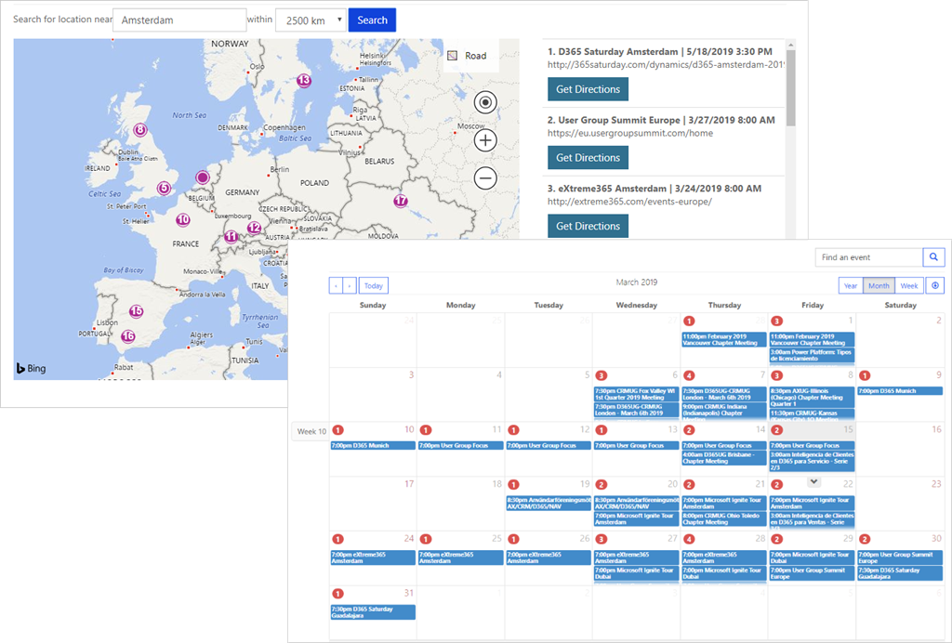
Configuration – Display options
Views can be rendered as traditional grid lists, a calendar, or a map. Delivering list content as an OData feed is also supported.
Notes:
Alternative views might require some additional configuration such as start and end date fields for a calendar or latitude and longitude fields for a map.
Important
Map and calendar views require page templates that can render the view. When a starter portal is provisioned, Rewrite page templates like Page or Full Page support this functionality. Pages that use web templates will render the default entity list view.

Slide 26
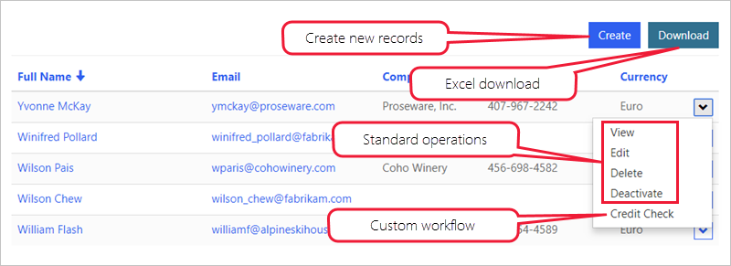
Actions
Entity lists can have actions associated with them to enable per list commands, like Create and Download (as a Microsoft Excel spreadsheet), or per record commands like View or Edit, and to trigger workflows.
Notes:
Entity lists can have actions associated with them to enable per list commands, like Create and Download (as a Microsoft Excel spreadsheet), or per record commands like View or Edit, and to trigger workflows.
For more information, see About entity lists.
Possible demo Or Watch the following video together to learn how to configure and display the view on a portal page and add interactive filtering capabilities on an existing Common Data Service entity.
[!VIDEO https://www.microsoft.com/videoplayer/embed/RE4ArhG]
Now that you've observed how the entity lists are built and rendered, you can learn how portals can display and interact with individual records.

Slide 27
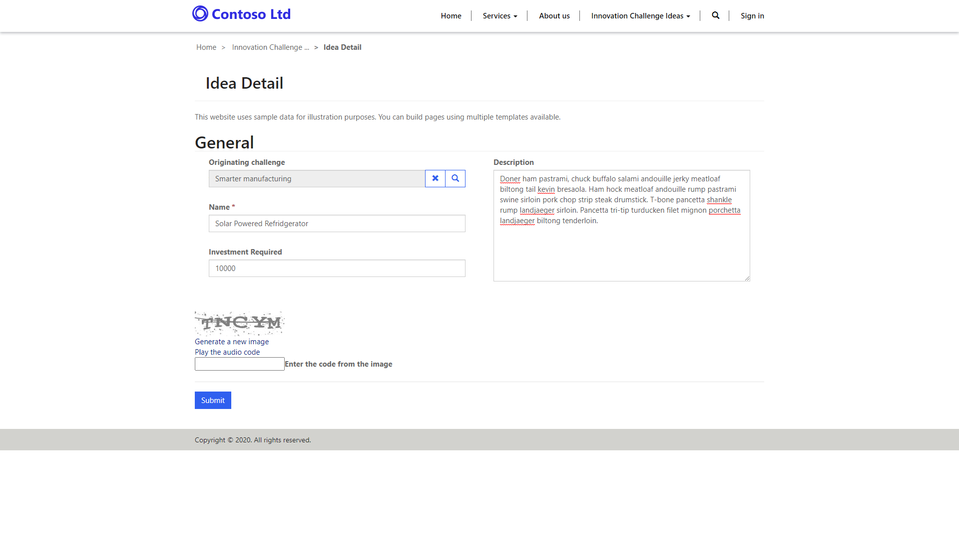
Use entity forms to interact with Common Data Service data
Entity Forms add the ability for portal pages to interact with records in a specific entity by using a model-driven form definition as a layout template.
Notes:
Entity Forms add the ability for portal pages to interact with records in a specific entity by using a model-driven form definition as a layout template. Similar to entity lists, entity forms are data-driven configurations that allow users to add a form to collect or display data in the portal without the need for a developer to create a custom form. Entity forms are defined by using model-driven forms and can be placed into webpages in the portal.
Entity forms can display most field types and subgrids but, currently, they can't display Power Apps Component Framework controls.

Slide 28
Common uses
The following table explains the common scenarios where entity forms can be used.
Scenario | Description
Layout | Entity forms can be configured and used in read-only mode as a layout mechanism. Think of entity forms as informational pages about employees, products, or any other Common Data Service entity. For example, you might have a custom entity in your Common Data Service instance that describes open positions that are available within your organization. Instead of crafting a special template to render the page, you can create a separate model-driven form for the entity, create a new webpage by using portals Studio, and then add an Entity Form component to the page. Any published changes in a form layout in a model-driven app will automatically apply to the webpage.
Information capture | Forms can be used on the portal for data capture from anonymous or authenticated users. For example, a simple lead entity form might be rendered on a Contact Us page to record anonymous requests as leads in Dynamics 365 Sales. For authenticated users, a portal might use a survey page to collect product feedback from customers into a custom Product Feedback entity.
Record management | Typically used in authenticated scenarios, entity forms allow various combinations of Create, Retrieve, Update, and Delete (CRUD) operations on an entity to be defined within a set of related webpages. For example, customers can retrieve and read their own cases and create new ones, partners can edit their company profiles, and employees can view the list of assets that are allocated to them by the company.
Web apps | Entity forms, when used in conjunction with entity lists and subgrids, and with the functionality extended by JavaScript, allow developers to build complete web applications.
Notes:
The following table explains the common scenarios where entity forms can be used.
Scenario Description
Layout
Entity forms can be configured and used in read-only mode as a layout mechanism. Think of entity forms as informational pages about employees, products, or any other Common Data Service entity. For example, you might have a custom entity in your Common Data Service instance that describes open positions that are available within your organization. Instead of crafting a special template to render the page, you can create a separate model-driven form for the entity, create a new webpage by using portals Studio, and then add an Entity Form component to the page. Any published changes in a form layout in a model-driven app will automatically apply to the webpage.
Information capture
Forms can be used on the portal for data capture from anonymous or authenticated users. For example, a simple lead entity form might be rendered on a Contact Us page to record anonymous requests as leads in Dynamics 365 Sales. For authenticated users, a portal might use a survey page to collect product feedback from customers into a custom Product Feedback entity.
Record management
Typically used in authenticated scenarios, entity forms allow various combinations of Create, Retrieve, Update, and Delete (CRUD) operations on an entity to be defined within a set of related webpages. For example, customers can retrieve and read their own cases and create new ones, partners can edit their company profiles, and employees can view the list of assets that are allocated to them by the company.
Web apps
Entity forms, when used in conjunction with entity lists and subgrids, and with the functionality extended by JavaScript, allow developers to build complete web applications.

Slide 29
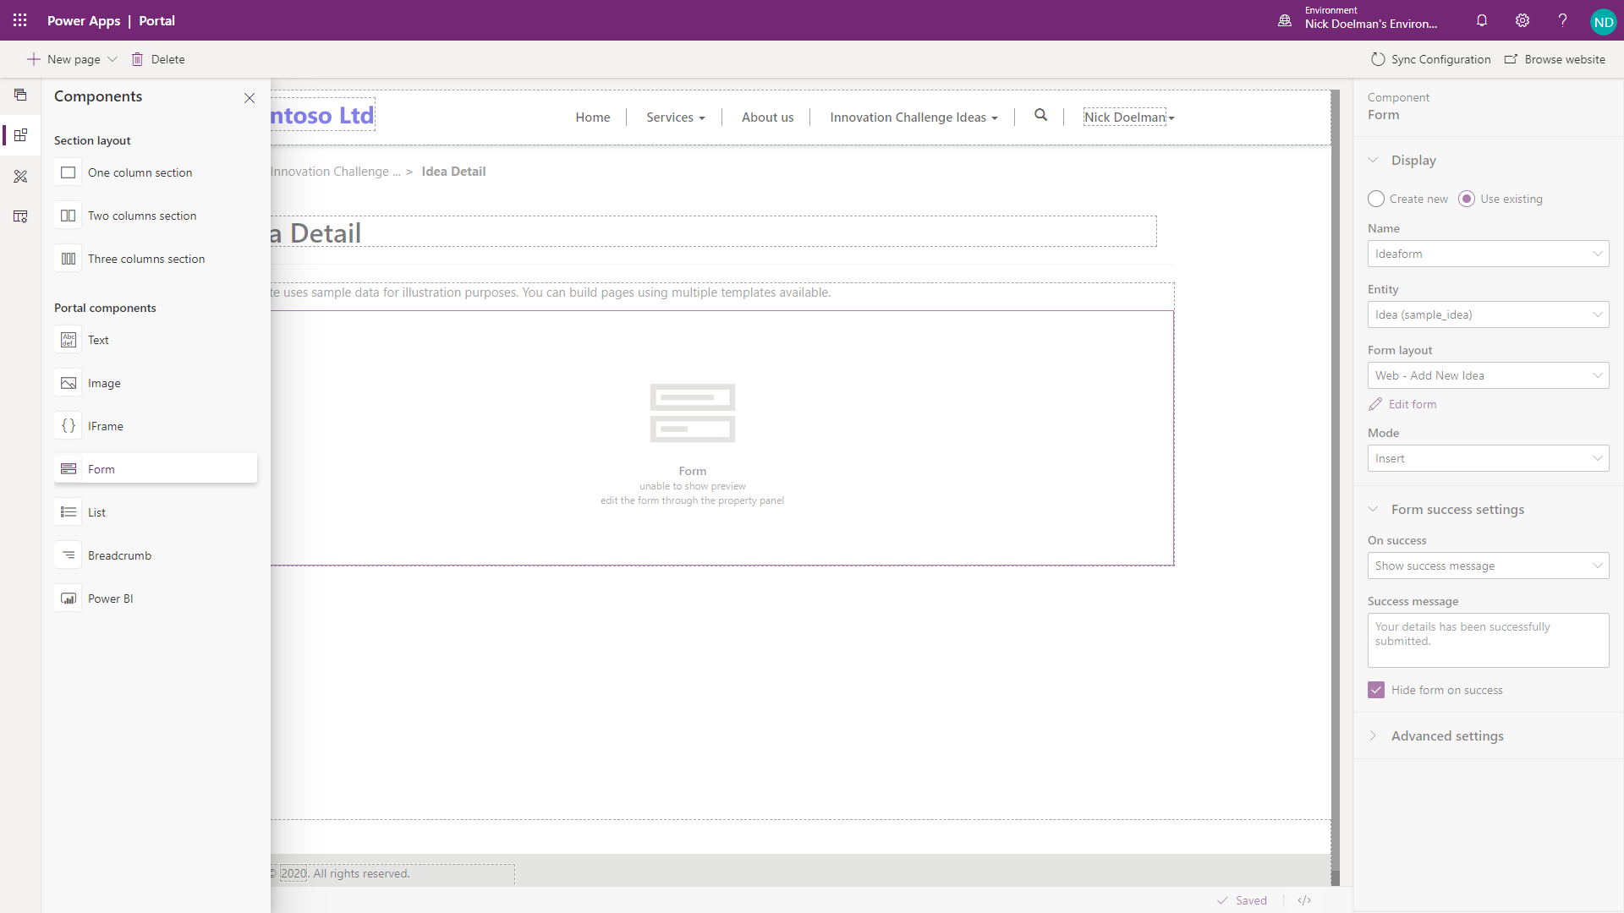
Create an entity form
Notes:
When creating a new entity form, your first step is to decide the Entity and Form Name that you will be rendering.
While reuse of forms that are part of a model-driven app is possible, the common practice is to design portal-specific model-driven forms (that might or might not be included in the model-driven apps).
Entity Form in Portal Studio
Portal forms are more concise with less information presented, especially when external audiences are involved.
Portal processes are separate from the internal use of a staff-facing, model-driven app (including Dynamics 365 apps). Dedicated portal forms are easier to maintain because any changes in the model-driven apps need to be manually applied to the portal forms, giving you an opportunity to review the requirements and assess usability aspects.
Certain limitations exist on the form and fields that are rendering, for example, PCF controls are not rendered. For more information, see About entity forms.
Client-side business rules and JavaScript, which are essential parts of a model-driven form, will not run on the portal. It's easy to overlook and might result in unintended consequences.
Special considerations need to be given when you are rendering related records, notes, and a timeline because not all functional aspects are supported (or required) in the portals.

Slide 30
Mode
The form mode can be Read Only, Insert, or Edit.
Query String - This setting is default when you are creating an entity form in portals Studio.
Current Portal User - When this option is selected, the form will load the information from the current portal user record without using additional information from the page URL.
Record Associated to Current Portal User - Selecting this option allows you to edit associated records, such as the current user's parent account details.
Notes:
The form mode can be Read Only, Insert, or Edit. This mode defines if the form is used to generate a layout, capture the data, or provide full editing capabilities for Common Data Service records.
[!NOTE] A form that is in Edit mode will be rendered as Read Only if the user does not have write privileges for the record.
If the mode is Insert, no additional information is required. For Read Only and Edit modes, the form will need to "know" the entity record to display and update. The Record Source Type setting defines how this information is passed to the form:
Query String - This setting is default when you are creating an entity form in portals Studio. When the page that contains the form is displayed, the record identifier is expected to be part of the query string, for example https://contoso.powerappsportals.com/contacts/edit/?id=<contact guid>. Usually, this setting is done automatically when the form is linked to an entity list. This setting is by far the most common.
Current Portal User - This option is configured within the Portal Management app. When this option is selected, the form will load the information from the current portal user record without using additional information from the page URL. Commonly, this option is used to render a user profile form. The Entity Name field in this case must be set to Contact because portal users are represented by the contact entity.
Record Associated to Current Portal User - This option is configured within the Portal Management app. Selecting this option allows you to edit associated records, such as the current user's parent account details. Relationship Name must be specified to identify the record to edit. The entity type that is selected must match the selection in the Entity Name field. This option is useful in partner scenarios where the partner organization would have multiple portal users. Some of these users could be authorized to edit the parent account record.
Entity, Form, and Mode are the details that are required to render the form.

Slide 31
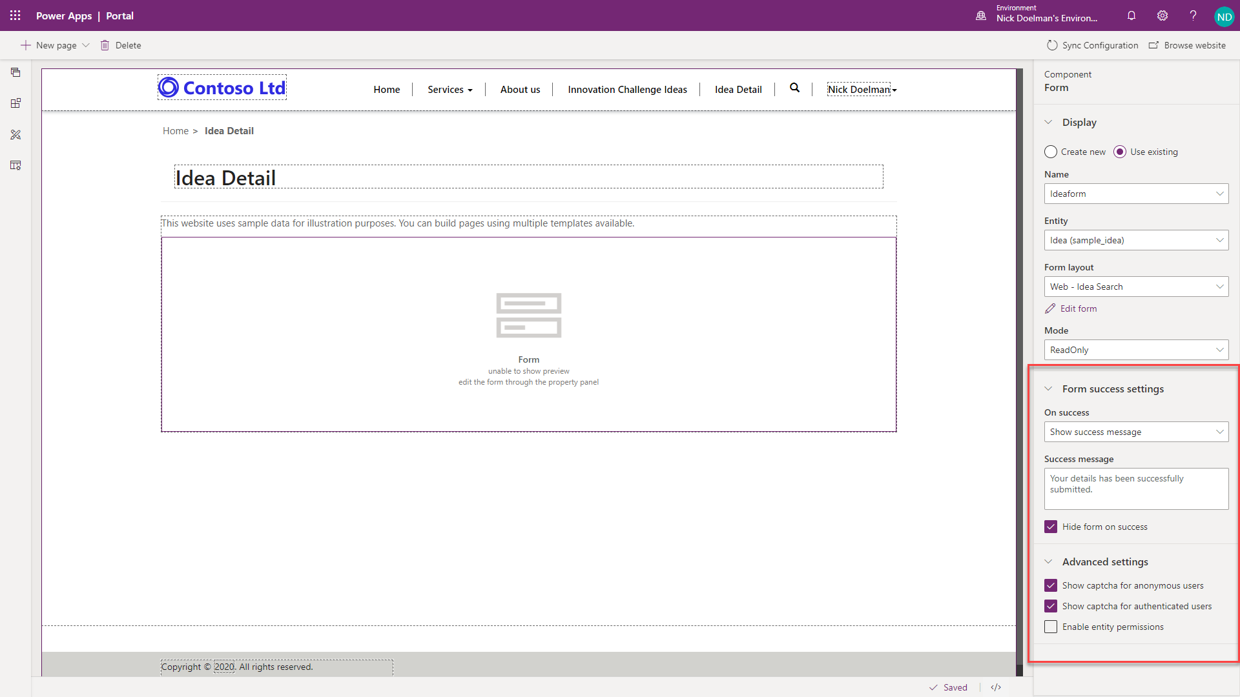
Configure the entity form
Additional configuration options to control form appearance and behavior are available within portals Studio.
Notes:
Additional configuration options to control form appearance and behavior are available within portals Studio.
Form success settings
The form success settings determine the actions that are taken when a form is successfully submitted to a portal.
Show success message - Shows a message when a form is submitted.
Redirect to webpage - Automatically navigates to a webpage on success of the form submission.
Redirect to URL - Redirects to a URL (portal or external).
Advanced settings
The Advanced settings feature determines if a captcha is displayed for anonymous or authenticated users. Also, the setting helps determine if entity permissions are enabled for the particular entity.

Slide 32
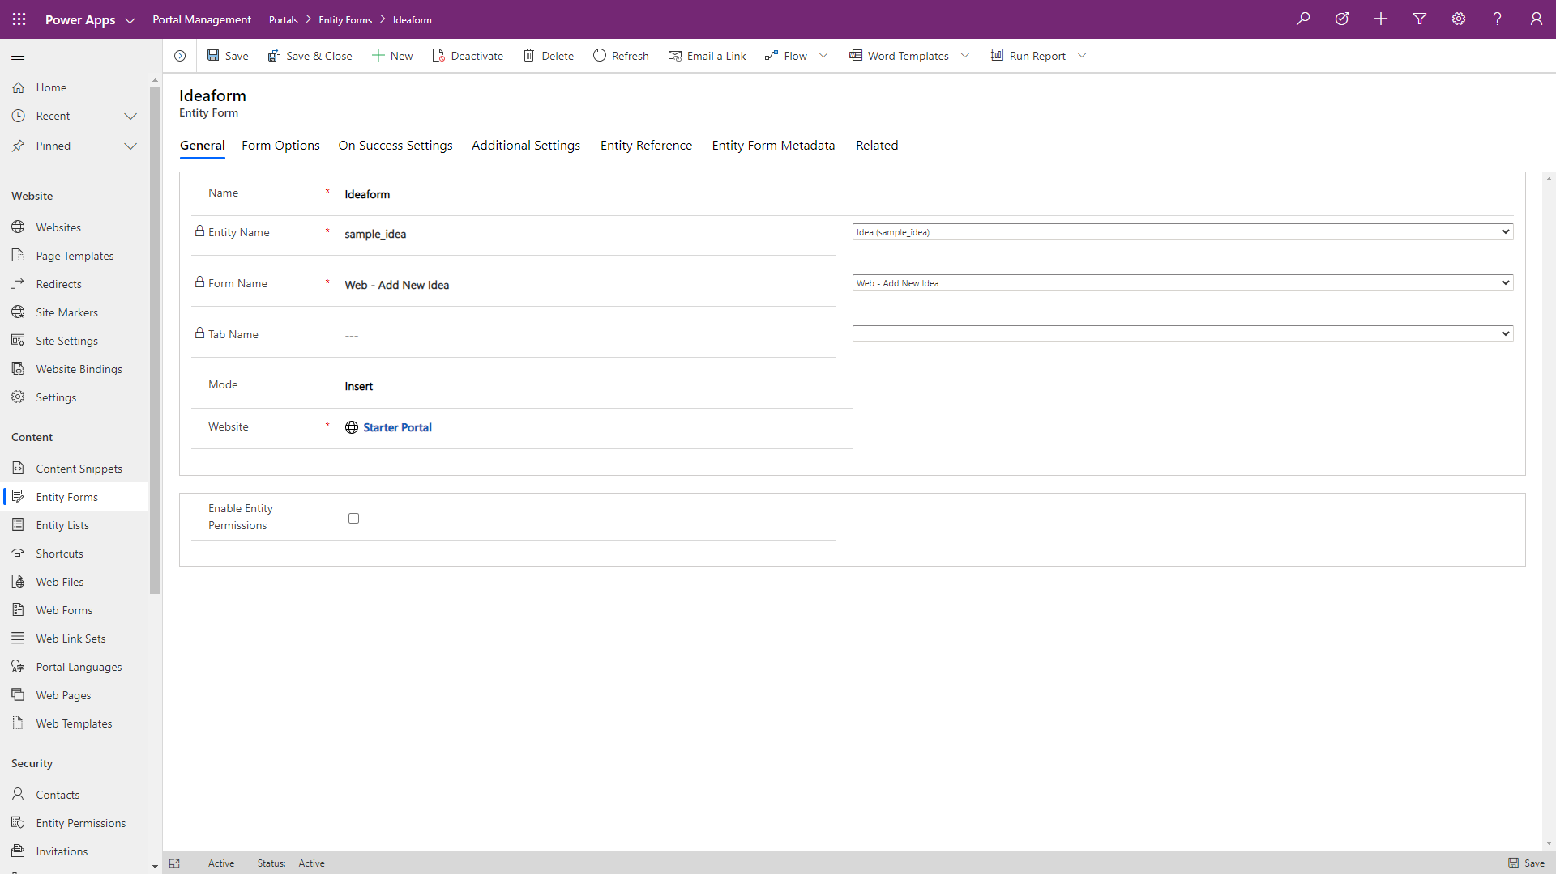
Additional entity form settings
Additional configuration settings are available for entity forms in the Portal Management app.
Notes:
Additional configuration settings are available for entity forms in the Portal Management app. To access an entity form in the Portal Management app:
Go to the Power Apps maker portal.
Select the target environment by using the environment selector in the upper-right corner.
From the Apps list, locate and open the Portal Management app (type will be Model-driven).
Select Entity Forms in the left navigation.
Open the form that you previously created in portals Studio.
Forms can include Actions for the user to interact with the record. Detailed configurations for each form element are available by using additional Entity Form Metadata records.
[!div class="mx-imgBorder"] Entity form structure

Slide 33
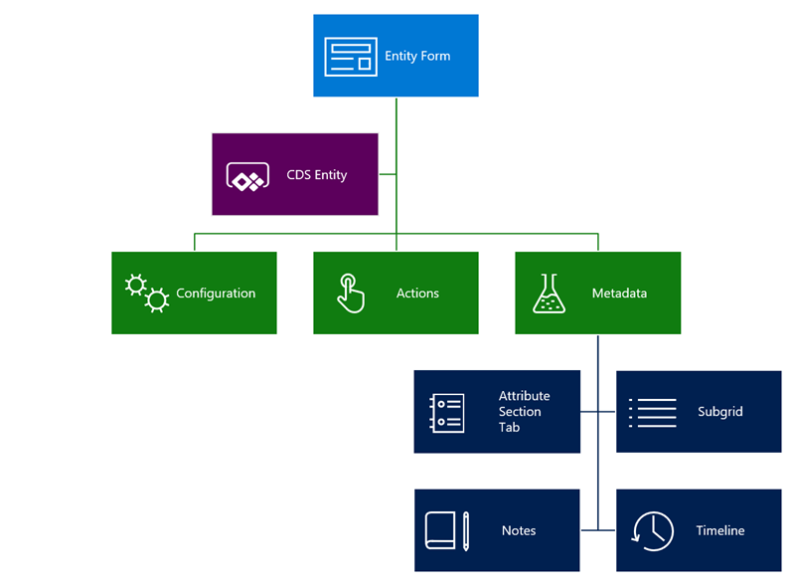
Additional entity form settings
Notes:
Forms can include Actions for the user to interact with the record. Detailed configurations for each form element are available by using additional Entity Form Metadata records.
Entity form structure

Slide 34
Configuration
Form options
Most form options support customization of the Cascading Style Sheets (CSS) elements to change visual appearance. Text elements such as labels, messages, and tooltips can be specified in multiple languages. For example, the default message after the form submission is "Saved," but it can be customized for each of the enabled portal languages.
Another form option includes Control validation behavior, where you can determine whether to mark all fields as required regardless of the form setting, for example.
Notes:
The following sections describe the different ways that you can configure entity forms.
Most form options support customization of the Cascading Style Sheets (CSS) elements to change visual appearance. Text elements such as labels, messages, and tooltips can be specified in multiple languages. For example, the default message after the form submission is "Saved," but it can be customized for each of the enabled portal languages.
Another form option includes Control validation behavior, where you can determine whether to mark all fields as required regardless of the form setting, for example.
Additional settings define other aspects of form behavior, such as styling, translation of the UI elements, and so on.
[!TIP] Some of the settings and configuration options are hidden. Select the Advanced settings check box to display all available options.
Associate current portal user on insert - This option can be used to keep track of which portal contacts created or updated the record. This setting creates a portal equivalent of the Created By and Modified By fields in Common Data Service. You can also set parental relationships where applicable. For example, if a new account record is created, you might want to set the current contact as a primary contact automatically.
Add attach file - A number of options are available to add a file upload control to your form. Configuration is flexible and supports multiple files, storage options, mime type, and size restrictions (for example, you can restrict uploads to images up to 2 MB in size).
Geolocation - An entity form can be configured to display a map control to display an existing location as a pin on a map or to provide a user with the ability to specify a location. For more information, see Add Geolocation.
The form's map control requires additional configuration to tell it what the various location fields are, to assign values to them, or retrieve values from them. For more information, see Geolocation configuration for entity forms.
[!div class="mx-imgBorder"] Entity form with geolocation enabled
Entity reference provides a way to associate the current record that is being created or updated with another target record. This feature is useful if you have multiple steps with multiple entity types and want to relate the resulting records or if the page is passed in a query string of a record ID that you want to associate.
For example, you might have an event page that displays information about an upcoming webinar. You want to include a registration button that redirects visitors to the registration page where the registration form is displayed. You can pass the event identifier in a query string and, when the registration form is submitted, you'll be able to automatically link the registration information to the event.

Slide 35
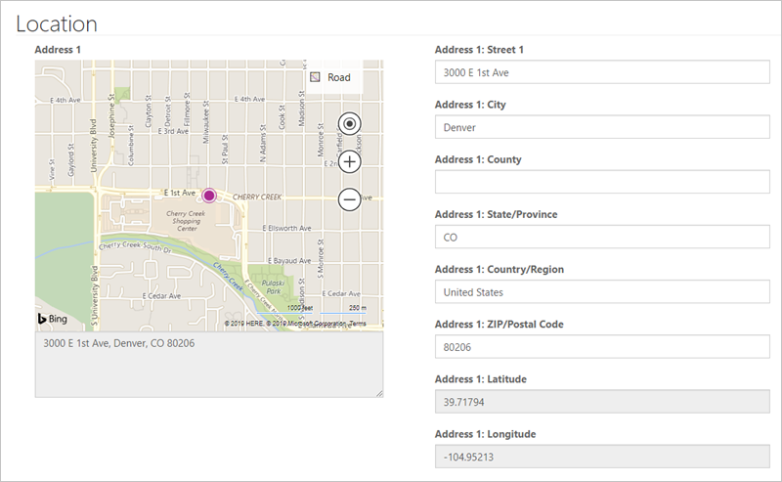
Configuration
Additional settings
Associate current portal user on insert
Add attach file
Geolocation
Notes:
Additional settings
Additional settings define other aspects of form behavior, such as styling, translation of the UI elements, and so on.
Tip
Some of the settings and configuration options are hidden. Select the Advanced settings check box to display all available options.
Associate current portal user on insert - This option can be used to keep track of which portal contacts created or updated the record. This setting creates a portal equivalent of the Created By and Modified By fields in Dataverse. You can also set parental relationships where applicable. For example, if a new account record is created, you might want to set the current contact as a primary contact automatically.
Add attach file - A number of options are available to add a file upload control to your form. Configuration is flexible and supports multiple files, storage options, mime type, and size restrictions (for example, you can restrict uploads to images up to 2 MB in size).
Geolocation - An entity form can be configured to display a map control to display an existing location as a pin on a map or to provide a user with the ability to specify a location. For more information, see Add Geolocation .
The form's map control requires additional configuration to tell it what the various location fields are, to assign values to them, or retrieve values from them. For more information, see Geolocation configuration for entity forms .

Slide 36
Entity reference
Entity reference provides a way to associate the current record that is being created or updated with another target record. This feature is useful if you have multiple steps with multiple entity types and want to relate the resulting records or if the page is passed in a query string of a record ID that you want to associate.
Notes:
Entity reference
Entity reference provides a way to associate the current record that is being created or updated with another target record. This feature is useful if you have multiple steps with multiple entity types and want to relate the resulting records or if the page is passed in a query string of a record ID that you want to associate.
For example, you might have an event page that displays information about an upcoming webinar. You want to include a registration button that redirects visitors to the registration page where the registration form is displayed. You can pass the event identifier in a query string and, when the registration form is submitted, you'll be able to automatically link the registration information to the event.

Slide 37
Actions
Because an entity form deals with an individual entity record, numerous actions can be run against this record, such as Update, Delete, Deactivate, and so on.
Notes:
Because an entity form deals with an individual entity record, numerous actions can be run against this record, such as Update, Delete, Deactivate, and so on. These actions, that at runtime are displayed as command buttons, can be configured by selecting Additional Settings > Action Button Configuration.
All commands include options to rename the buttons and change their placement on the form.

Slide 38
Entity form metadata
Entity form metadata records allow you to control the appearance and behavior of individual form elements, including:
Appearance of the fields, sections, and tabs. An individual field's default values, validation behavior, and other aspects can be defined.
Subgrids configuration, which allows you to define actions for related records, similar to entity list actions.
Behavior of notes and timeline sections, and if new records can be added. This option is commonly used to allow portal users to enter comments about the record, for example, a case in process.
Notes:
Entity form metadata records allow you to control the appearance and behavior of individual form elements, including:
Appearance of the fields, sections, and tabs. An individual field's default values, validation behavior, and other aspects can be defined.
Subgrids configuration, which allows you to define actions for related records, similar to entity list actions.
Behavior of notes and timeline sections, and if new records can be added. This option is commonly used to allow portal users to enter comments about the record, for example, a case in process.

Slide 39
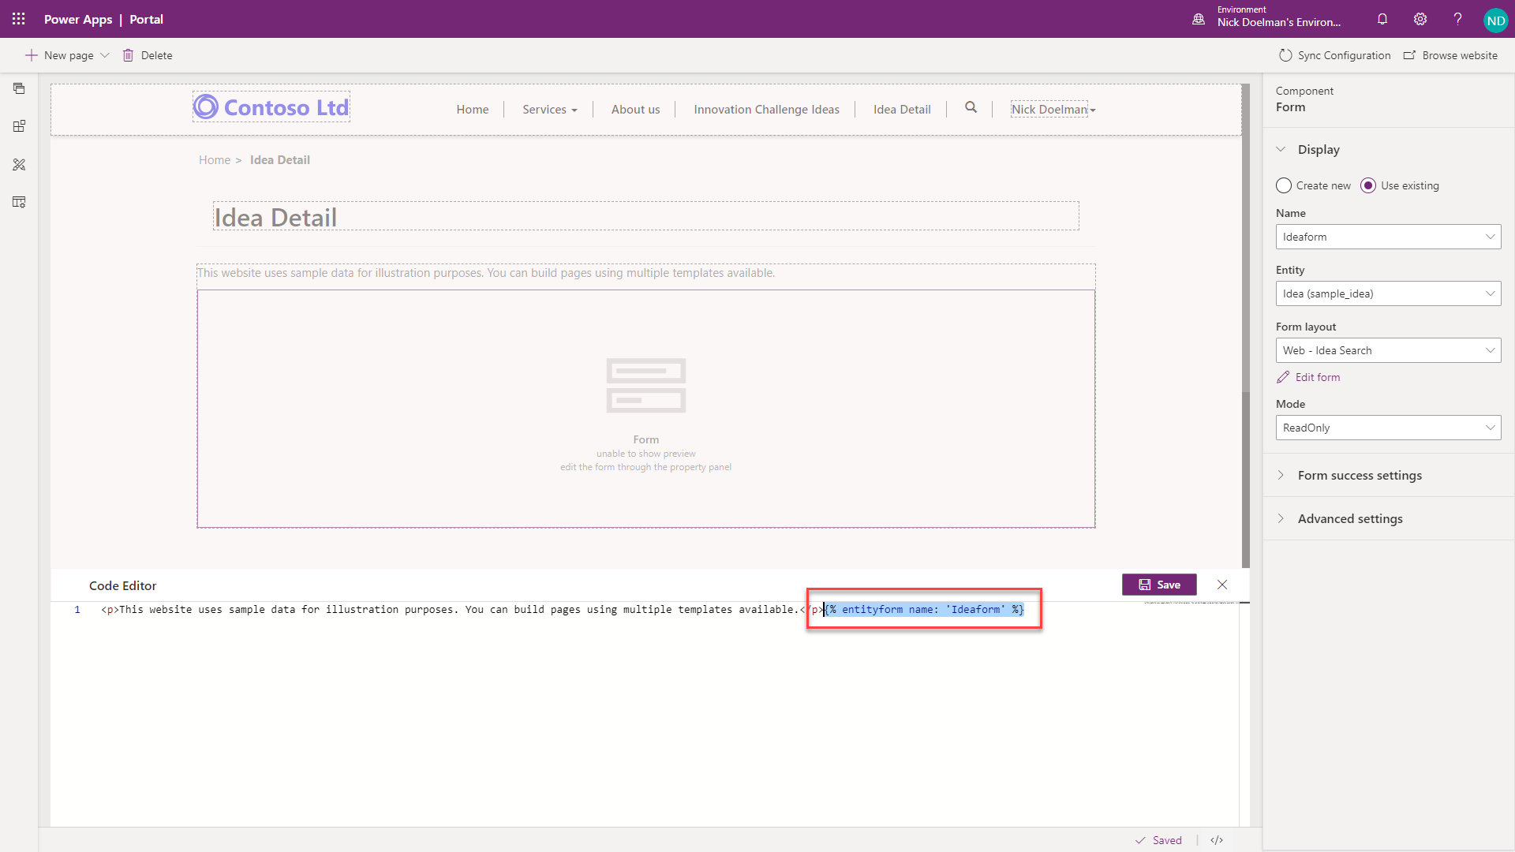
Add an entity form to your portal
An entity form defines the required behavior but does not contain information about how and where on the site that the form should be rendered.
Text
{% entityform name: '<<entity form name>>' %}
Notes:
An entity form defines the required behavior but does not contain information about how and where on the site that the form should be rendered. Two methods to render an entity form in a portal are:
The entity form can be explicitly specified as a target for an entity list action like Create, Update, or Edit. In this case, the form will be rendered in a modal pop-up window. Certain limitations apply when the form is rendered in a pop-up window, for example, the ability to create related records from subgrids is not available.
Similar to an entity list, an entity form component can be added to a webpage from portals Studio. This action will place a Liquid tag on the webpage copy to render the entity form.
{% entityform name: '<<entity form name>>' %}
Entity form to render
Because forms can submit information back to the server for processing, you will have less control over the rendering of entity forms as compared to the entity lists.
The following video shows how to extend entity list functionality with entity forms and display a Common Data Service record in a pop-up window or on a separate webpage.
[!VIDEO https://www.microsoft.com/videoplayer/embed/RE4AjtN]

Slide 40
Exercise: Use an entity list and entity form
Follow the exercise in the student manual
Notes:
Link: https://docs.microsoft.com/en-us/learn/modules/portals-access-common-data-service/4-exercise

Slide 41
Extend Power Apps portals

Slide 42
Introduction
A variety of configuration-only tools and features are available for building a Microsoft Power Apps portals application.
Liquid template language in portal pages and templates begins to extend your web application and allows you to manipulate and display content in a variety of ways.
Power Apps portals features can also be further extended by using standard web technologies such as HTML, JavaScript, and Cascading Style Sheets (CSS).
You might also encounter situations where you need to update or create data in Common Data Service without submitting an entity form or a web form. A common method is to build a standalone web application with an API that can be called from the Power Apps portal and that will act as a liaison to update Common Data Service.
Notes:
A variety of configuration-only tools and features are available for building a Microsoft Power Apps portals application. Examples of these tools and features include entity lists, entity forms, web forms, and the ability to integrate other technologies such as SharePoint and Microsoft Power BI. You might encounter features that are not easily configured by using the available low-code or no-code features.
Liquid template language in portal pages and templates begins to extend your web application and allows you to manipulate and display content in a variety of ways.
Power Apps portals features can also be further extended by using standard web technologies such as HTML, JavaScript, and Cascading Style Sheets (CSS).
You might also encounter situations where you need to update or create data in Common Data Service without submitting an entity form or a web form. A common method is to build a standalone web application with an API that can be called from the Power Apps portal and that will act as a liaison to update Common Data Service.
After you have configured and customized your portal, another concern that you might have is determining how to ensure that your work is saved in a source control system and how to ensure that your portal can be deployed to a test or production portal.

Slide 43
Server-side extensibility
Power Apps portals do not support client-side business rules, JavaScript web resource, or Power Apps component framework controls that are commonplace with the model-driven forms.
Entity-scope business rules still apply because they are implemented on the server.
Workflows and Microsoft Power Automate flows are still triggered, regardless of whether a triggering action was run inside a model-driven app or a portal. The workflows can also be called explicitly by using form configuration on the portal.
When a portal user interacts with Common Data Service records, the server-side code runs as usual. Developers can pass relevant portal context to plug-ins when the records are updated by portal users who are employing entity forms. That approach adds some server-side code extensibility to the portals and enables various integration scenarios.
Notes:
Power Apps portals do not support client-side business rules, JavaScript web resource, or Power Apps component framework controls that are commonplace with the model-driven forms. As a result, portal deployments will occasionally become blocked because expectations of the same or similar form behavior can't be met. Instead, entity lists, entity forms, and web forms include a custom JavaScript option that allows developers to add scripts that implement equivalent functionality.
However, the portals are based on model-driven apps that are underpinned by Common Data Service. In fact, portals deliver functionality that is already available in a model-driven app but only to the portal users, meaning that:
Entity-scope business rules still apply because they are implemented on the server.
Workflows and Microsoft Power Automate flows are still triggered, regardless of whether a triggering action was run inside a model-driven app or a portal. The workflows can also be called explicitly by using form configuration on the portal.
When a portal user interacts with Common Data Service records, the server-side code runs as usual. Developers can pass relevant portal context to plug-ins when the records are updated by portal users who are employing entity forms. That approach adds some server-side code extensibility to the portals and enables various integration scenarios.

Slide 44
Development life cycle
Application lifecycle management (ALM) is important as the applications that your organization builds become more complex and as more of your company depends on their stability.
Notes:
Application lifecycle management (ALM) is important as the applications that your organization builds become more complex and as more of your company depends on their stability.
If you create a model-driven Power App, a Power Automate flow, or any other object to build a business solution on a Common Data Service environment, you would typically contain these assets in a solution and export the single solution file from one environment to another. The solution file can also be unpacked into discreet file components and uploaded to a source control system (such as Microsoft Azure DevOps) that will maintain a repository of the solution and track the various changes. Many tools are provided by Microsoft and the community to automate the ALM process.
For more information, see Application lifecycle management (ALM) with Microsoft Power Platform.

Slide 45
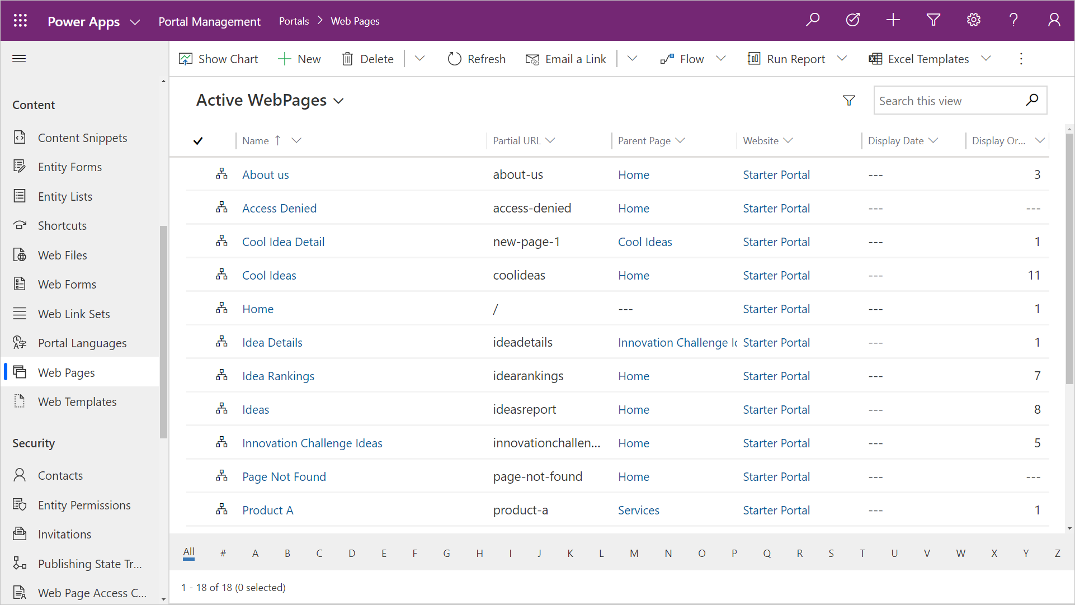
Portal metadata
Power Apps portals configuration is stored directly within Common Data Service as records known as portal metadata.
Notes:
Power Apps portals configuration is stored directly within Common Data Service as records known as portal metadata. When you provision a Power Apps portal, the portal template that you choose will populate a number of portal-specific Common Data Service entities with data that describe the website structure, webpages, content, entity list configuration, entity form configuration, and so on. As you configure the portal by using Power Apps portals Studio or other tools, you are changing or adding to the portal metadata.
Portal metadata can't be added to a Common Data Service solution file. The challenge is how to move the portal metadata records from one environment to another. While model-driven Power Apps have built-in features to export and import data, these features work for a single entity and must be sequenced based on data relationships.
Portal metadata is stored in over 50 interconnected, unique entities. In addition, functionality is built into the portal solutions that will be triggered as records are created. For example, as a webpage record is added to the portal, a corresponding webpage record will be created for each provisioned language. Using an import tool might inadvertently duplicate webpage records.
You can move portal metadata from one environment to another by using tools that are available from the community and Microsoft.

Slide 46
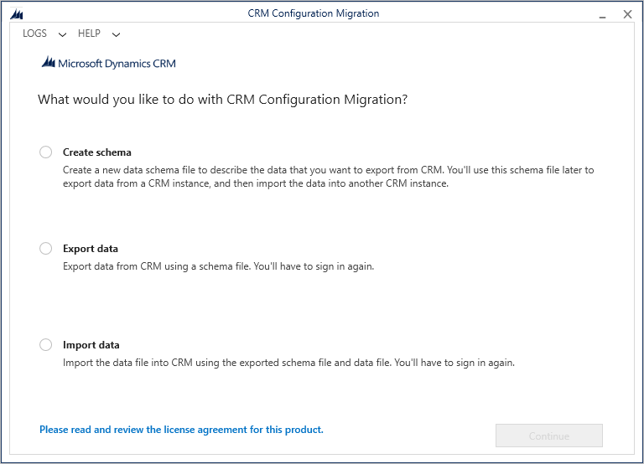
Configuration Migration tool
The Configuration Migration tool is an application that can be run as a Windows desktop application or invoked as a PowerShell cmdlet.
Notes:
The Configuration Migration tool is an application that can be run as a Windows desktop application or invoked as a PowerShell cmdlet. The tool can export and import a set of Common Data Service records and maintain the entity relationships.
[!NOTE] The Configuration Migration tool is designed for smaller datasets (specifically configuration data, such as portal metadata) and is not suited for high-volume data migrations or integrations.
The Configuration Migration tool will use a schema file to determine which Common Data Service entities to export to a data file. Microsoft has a predefined schema file for each of the portal templates to identify the specific portal metadata Common Data Service entities.
After you have set up your Power Apps portal configuration, you can run the Configuration Migration tool to export your portal metadata to an XML file by using the schema that corresponds to your portal template.
Ideally, the portal metadata file should be uploaded to a source control repository, where the changes can be tracked and used to deploy to other environments.
You will also need to deploy any configurations that are made to Common Data Service, such as new entities and model-driven forms and views that are used by portal entity lists and entity forms. You would move this configuration by using solutions. For more information, see Solutions Overview.
On your destination environment, you can then run the Configuration Migration tool to import the portal metadata file to update the portal configuration.
[!CAUTION] Using the Configuration Migration tool will move over all and overwrite existing portal metadata. Situations might occur where content is specific to the environment (for example, hyperlinks to specific URLs). After the data has been migrated, you might need to update some content directly in the destination portal.
For more information, see Migrate portal configuration.

Slide 47
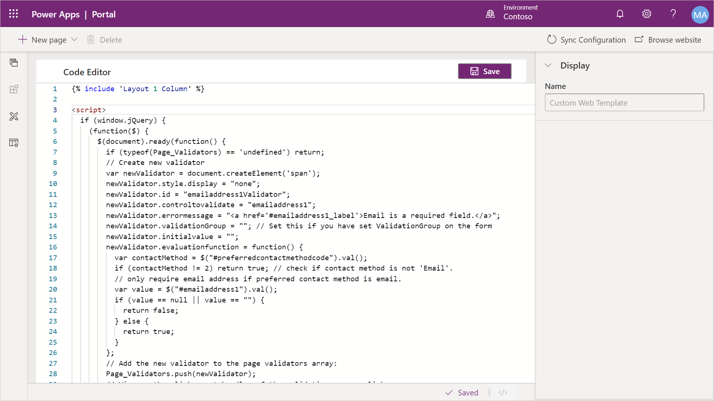
Extend with scripts
Power Apps portals does not support client-side business rules or custom JavaScript processes that are available on model-driven forms.
Notes:
Power Apps portals does not support client-side business rules or custom JavaScript processes that are available on model-driven forms. However, custom JavaScript can be added directly to a portal page in the Power Apps portals Studio source code editor and to web templates.
[!div class="mx-imgBorder"] JavaScript in Portal Studio
In addition, the Entity Lists, Entity Forms, and Web Forms features include a custom JavaScript field that allows developers to add scripts that implement the required functionality.
The functionality can range from hiding controls, to replacing input controls with user-friendly equivalents, to invoking external web services and implementing sophisticated integration scenarios.
Out of the box, Power Apps portals includes the jQuery library that makes manipulation of page content and appearance a reasonably simple task.

Slide 48
Controls and fields
HTML
<script> $(document).ready ( function() { $("#subject").val('Submitted from contact us form'); // sets the value $("#subject").closest('tr').hide(); // hide the row containing the field } ); </script>
Notes:
A default Contact Us form that creates a lead in Common Data Service includes a mandatory Topic field. This field could be confusing to site visitors. You can't use CSS to hide the control because it leaves the red asterisk that indicates that the field is mandatory. JavaScript helps make your job of hiding the field relatively simple. To set this field to a predefined value and then hide it from view, go to portals Studio and add the following script to the source code of the page that contains the Contact Us form:
<script> $(document).ready ( function() { $("#subject").val('Submitted from contact us form'); // sets the value $("#subject").closest('tr').hide(); // hide the row containing the field } ); </script>

Slide 49
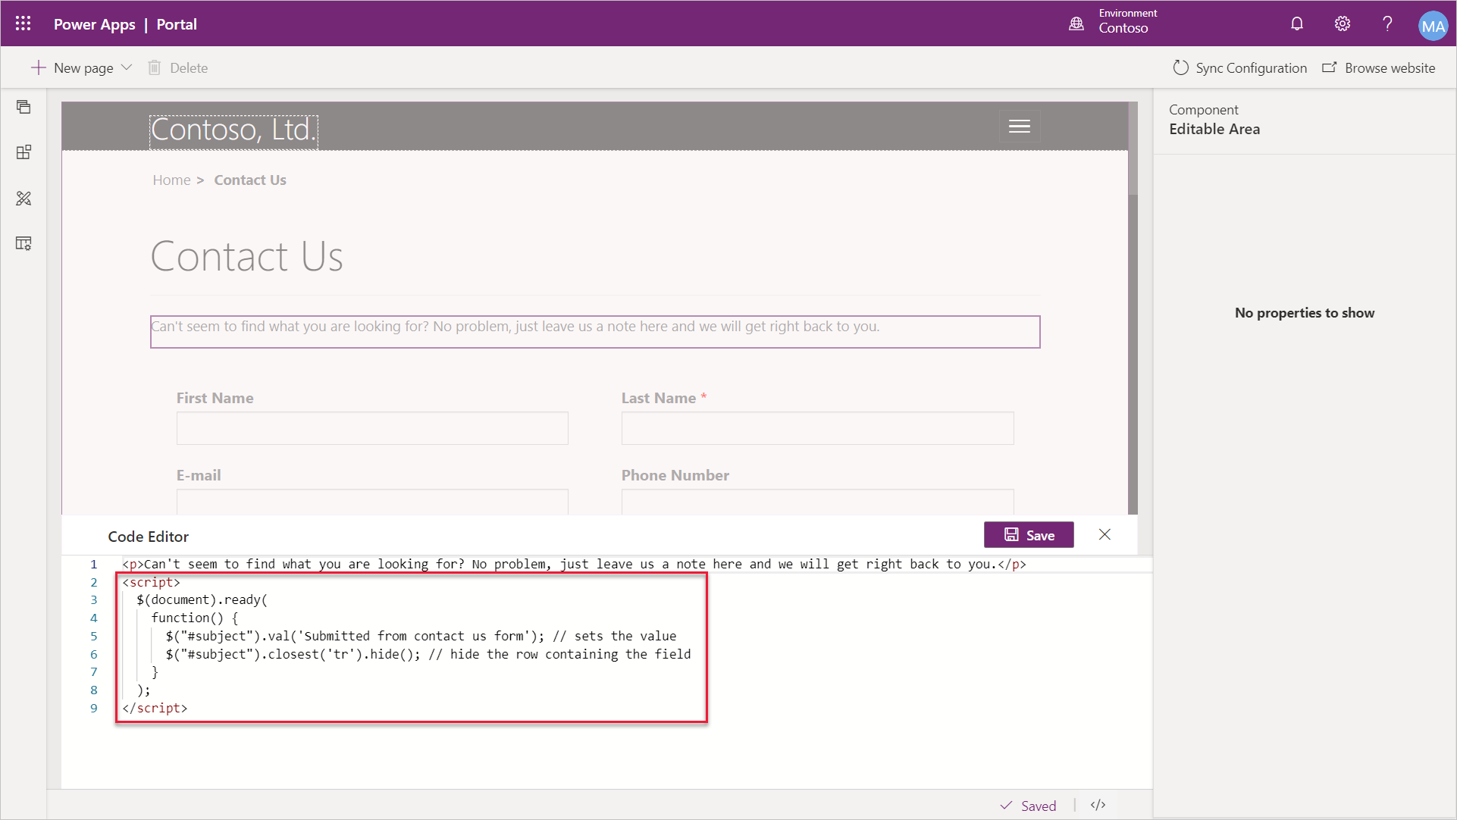
Controls and fields
Notes:
Add JavaScript to Page
JavaScript is a simple way to add supplementary behavior or functionality to your Power Apps portal. It can be added directly to a page or added to the Entity Form configuration (through the Portal Management app) or as part of a web template, depending on your scoping needs. Script can be used on the form to:
Implement business rules.
Add dependencies between elements like dependent option sets.
Perform additional form validation.
These options provide reasonable alternatives to client-side business rules and scripting in model-driven forms.
[!VIDEO https://www.microsoft.com/videoplayer/embed/RE4AmL6]
For more information, see Add custom JavaScript.

Slide 50
Advanced CSS
Making changes to the style of your portal pages can be as simple as applying CSS statements directly to a page in the Custom CSS field. For example, if you need to increase the height of the navigation bar at the top of a home page to fit a logo, you can edit the page properties and add a custom CSS statement.
CSS
.navbar-static-top.navbar { min-height: 100px; }
Notes:
Cascading Style Sheets (CSS) is a language that determines the style of a webpage by describing how its HTML elements are to be displayed, including text, fonts, colors, backgrounds borders, and margins.
Making changes to the style of your portal pages can be as simple as applying CSS statements directly to a page in the Custom CSS field. For example, if you need to increase the height of the navigation bar at the top of a home page to fit a logo, you can edit the page properties and add a custom CSS statement.
.navbar-static-top.navbar { min-height: 100px; }
[!NOTE] CSS statements that are added directly to a webpage will apply to that webpage only.
This approach works for small adjustments on a single page, but a better approach is to record customizations in one or more CSS files and then apply them to the entire portal or parts of it.

Slide 51
Portal themes
Portals use the Bootstrap front-end framework to control the design and layout of the website.
Notes:
Portals use the Bootstrap front-end framework to control the design and layout of the website. Bootstrap is a package of HTML and CSS design templates for typography, forms, buttons, navigation, and other elements, including optional JavaScript extensions. One appealing feature of Bootstrap is that it offers responsive layout out of the box; it automatically adjusts your website so that it has a pleasing appearance on all devices from small phones to large desktops.
A theme determines the appearance of all webpages in your portal to ensure visual consistency. It controls the navigational structure, the banner, colors and fonts, and other visual elements of a webpage.
The web templates that are included in a starter portal are implemented by using standard Bootstrap components with minimal additional custom styles. As a result, you can take advantage of the customization options that are provided by Bootstrap to tailor the theme in a way that's applied consistently to the entire portal.

Slide 52
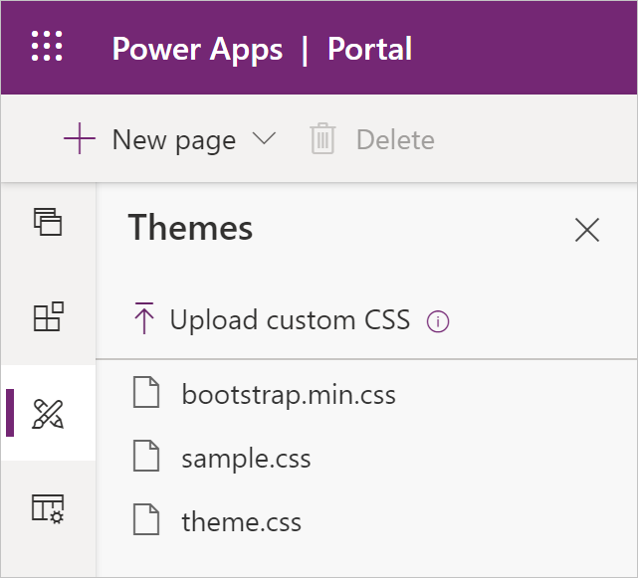
Upload custom CSS
Any starter portal has two files already included as child web files of the home page: bootstrap.min.css and theme.css.
Creating complete styling for the entire site and then replacing the content of the .css file. This method works well if you have access to skilled designers who can ensure that all relevant elements are defined. This approach creates centrally controlled styling and ensures consistency throughout the portal.
Redefining only the elements that require modifications, such as colors and font size. Create and upload the CSS file that contains only these incremental adjustments. This method works well if your target design is close to the starter portal design and only minor styling modifications are required. This approach allows incremental modifications that can be undone.
Notes:
Any starter portal has two files already included as child web files of the home page: bootstrap.min.css and theme.css. These files define the default styles and theme for your entire portal. You can upload and edit additional stylesheets in portals Studio by using the Themes section on the tool belt.
[!div class="mx-imgBorder"] CSS Editing
Make sure that you consider how you want to approach style modifications for your portal, such as:
Creating complete styling for the entire site and then replacing the content of the .css file. This method works well if you have access to skilled designers who can ensure that all relevant elements are defined. This approach creates centrally controlled styling and ensures consistency throughout the portal.
Redefining only the elements that require modifications, such as colors and font size. Create and upload the CSS file that contains only these incremental adjustments. This method works well if your target design is close to the starter portal design and only minor styling modifications are required. This approach allows incremental modifications that can be undone.
[!WARNING] If you decide to overwrite bootstrap.min.css or theme.css files, make sure that you download a backup copy of these files prior to replacing them. If your replacement CSS is invalid or incomplete, you will not be able to undo the replacement. Consequently, you will have to restore the content of these files, potentially using a Power Apps portals app if the portal is rendered non-functional.

Slide 53
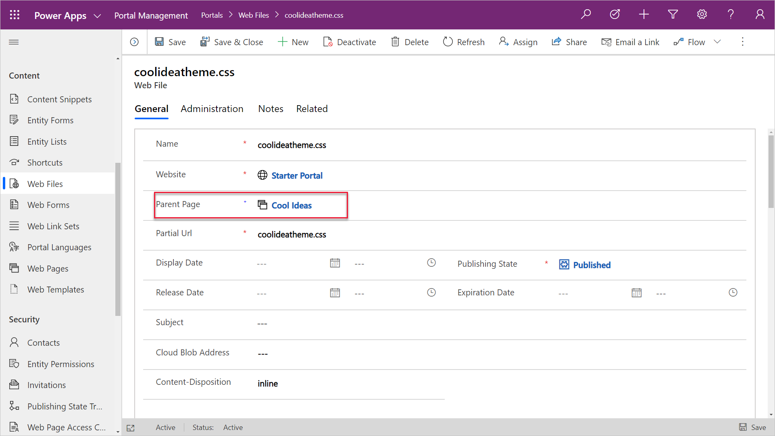
Apply customizations to specific portal areas
You can add customizations to specific pages or sections of your portal by adding a Web File record by using the Portal Management app with an attachment to a CSS file.
Notes:
You can add customizations to specific pages or sections of your portal by adding a Web File record by using the Portal Management app with an attachment to a CSS file. You will need to specify the parent page in the Web File record so that the theme will be applied to the parent page and all descendants of that page. This approach makes it possible for you to build fully customized sections of your site.
[!div class="mx-imgBorder"] Custom Theme for Section
[!IMPORTANT] The partial URL must end in .css for the portal to recognize it and apply it to the webpage and its child pages.

Slide 54
Apply customizations to specific portal areas
Customize Bootstrap
The standard way to create a custom version of Bootstrap is through the official Bootstrap site.
Background images
When you are starting portal customizations, one of the most common requests that you might have is to replace the background images.
Notes:
The standard way to create a custom version of Bootstrap is through the official Bootstrap site. However, due to the popularity of Bootstrap, many other sites have also been created for this purpose. These sites might provide a user-friendly interface for Bootstrap customization or predesigned versions of Bootstrap for you to download. The official Bootstrap customizer site has more information about Bootstrap customization.
[!TIP] When you are customizing Bootstrap, only select elements that require modification. For example, if you want to replace the standard fonts with your corporate standard fonts, select the Typography component of Bootstrap. This approach will help reduce the chances of accidentally rewriting other CSS elements.
After you have customized Bootstrap, it will generate one or more files that you would want to upload as web files. Unless your intent is to completely replace the original styles, make sure that you avoid using bootstrap.css, bootstrap.min.css, theme.css, or theme.min.css files in your partial URLs because of how the portal handles multiple CSS files.
Background images
When you are starting portal customizations, one of the most common requests that you might have is to replace the background images. These images are applied by using CSS, but they can be replaced without changing CSS. Look for .jpg web files under the portal's home page, for example homehero.jpg. Your only requirement is to replace the attachments of these web files with your own images. Make sure that the size of the new images is compatible to maintain consistent layout.

Slide 55
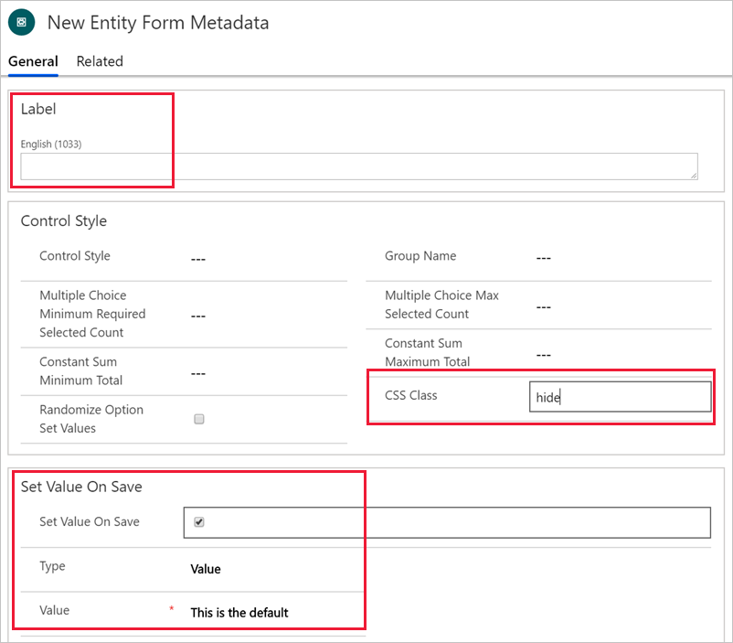
CSS for simple adjustments
CSS is often overlooked when simple adjustments are required, such as hiding the element or adjusting margins to fit a wide label.
Set Label to a single space.
Set CSS Class to hide.
Set the default value as required.
Notes:
CSS is often overlooked when simple adjustments are required, such as hiding the element or adjusting margins to fit a wide label. Bootstrap framework is the foundation of the styling in Power Apps portals, and it defines many styles that control appearance and multi-column responsive layout. For example, if you want to hide a particular field and submit a default value instead of collecting the user input, you can use Entity Form Metadata for the field and then define the following parameters:
Set Label to a single space.
Set CSS Class to hide.
Set the default value as required.
[!div class="mx-imgBorder"] Hide field and set default
Instead of resorting to JavaScript, you can accomplish this task by using configuration only. Using CSS, where possible, has certain advantages:
CSS applies on load; it's faster because you don't have to wait for the document to finish loading.
CSS is always on and continues to apply to the relevant elements, even if JavaScript changes the document structure and adds or removes the elements.
For certain tasks that are related to an element's visibility and responsive layout, CSS can be simpler to use than JavaScript, meaning less maintenance and less room for error.

Slide 56
Advanced client-side development
Using JavaScript and CSS to manipulate client-side visibility and functionality of portal pages can help you achieve considerable success in satisfying some key business requirements.
Partner libraries
API calls
Companion app
Notes:
Partner libraries
JavaScript can use other JavaScript libraries that deliver functionality such as UX enhancements (masked controls, for example), real-time communications (SignalR), sophisticated UI building (Angular, Vue, React), and other various business services like address validations, map API, routing services, logistics, and so on.
Power Apps portals create a clean, responsive layout with predictable element names, which helps make manipulating the data and UI easier.
For an example of a sophisticated implementation that can be hosted in Power Apps portals and that uses Angular framework for communications, go to the Set up the event website documentation for Dynamics 365 Marketing.
API calls
Combined with custom web templates that use Liquid code to deliver data instead of HTML, JavaScript can call back into Power Apps portals to retrieve the data and then use it to create alternative UX. For example, instead of using the Entity List calendar view, you can retrieve list data in JSON format instead and then use other calendaring libraries, like FullCalendar, to create sophisticated calendar visualization. Alternatively, you can retrieve opportunity data and use another charting JavaScript library for sophisticated interactive charting.
Important
When you use web templates, it is only possible to implement REST service for GET operations. No other operation, such as PUT, is supported by Liquid code.
Companion app
Situations might occur where you want to communicate securely with external services while maintaining the security context, such as when you are processing online payments. Power Apps portals enables this scenario by providing support for OAuth 2.0 implicit grant flow within your portal .
This feature allows a customer to make client-side calls to external APIs and secure them by using OAuth implicit grant flow. This method helps ensure that the identity information of a signed-in user is passed in a secured manner to the external calls.
In this scenario, you build a custom web application and Power Apps portals would communicate to this application by using JavaScript to call the API.
CSS and JavaScript enable a number of integration and extensibility scenarios that range from simple UI adjustments, to validation and data input, to sophisticated client-side applications that interact with other services.

Slide 57
Exercise: Add advanced client-side functionality
Follow the exercise in the student manual
Notes:
Link: https://docs.microsoft.com/en-us/learn/modules/extend-power-app-portals/6-exercise

Slide 58
Build custom Power Apps portals web templates

Slide 59
Introduction to portal web templates
Liquid is an open-source template language that can be used to add dynamic content to pages.
Notes:
Liquid is an open-source template language that can be used to add dynamic content to pages. Liquid code can be used anywhere in the portals where HTML or text content can be entered, including content in webpages, content snippets, and web templates.
Liquid has various language constructs that can help you build content, apply transformations, and control the implementation flow. Ability to access Common Data Service data by using FetchXML query language or directly retrieving entities by identifiers makes Liquid the primary choice for building data-driven webpages. It also includes a number of special tags (or processing instructions) that specifically target the building of reusable web templates. The following sections explain how templates are used in Microsoft Power Apps portals.

Slide 60
Templates
twig
<div class="container"> <div class="page-heading"> {% include 'Breadcrumbs' %} {% include 'Page Header' %} </div> <div class="row"> <div class="col-md-12"> {% block main %} {% include 'Page Copy' %} {% if page.adx_entitylist %} {% include 'entity_list' key:page.adx_entitylist.id %} {% endif %} {% if page.adx_entityform %} {% entityform id: page.adx_entityform.id %} {% endif %} {% endblock %} </div> </div> </div>
In Power Apps portals, the webpage does not define how the page looks when it's rendered on the portal.
Notes:
In Power Apps portals, the webpage does not define how the page looks when it's rendered on the portal. Instead, it's linked to the Page Template record that defines the layout and behavior.
The two types of templates that you can use in Power Apps portals are:
Rewrite - These templates use server-side processing to implement specialized behavior that is required by some of the components and special pages such as an error page, site map, search, and others.
Web Template - The linked layout template defines how the content of the page is rendered for output.
Rewrite templates offer limited customizations. Liquid template language can be used as part of the content or inside content snippets, but the page layout and behavior are predefined.
Contrarily, the Web Template option is entirely template-based and uses Liquid to define how the content is rendered. Templates are flexible. A template can include other templates for parts of the content. A template can also be based on another template, extending the base functionality. The real power of web templates comes from the ability to contain Liquid code that adds processing capabilities to the static content, including access to Common Data Service data.
[!TIP] Web templates can also contain HTML, Cascading Style Sheets (CSS), and JavaScript.
You can use web templates to define an entire webpage, a part of a page, or common elements such as the site header and footer. This approach creates a consistent appearance and behavior throughout the portal and helps make it easier to modify the appearance and data that is rendered. The following example shows what a typical simple template might look like:
This simple template includes other templates to render common bits and pieces, it defines content block that can be rendered differently by a derived template, and it renders Common Data Service data by using related Entity List and Entity Form records.

Slide 61
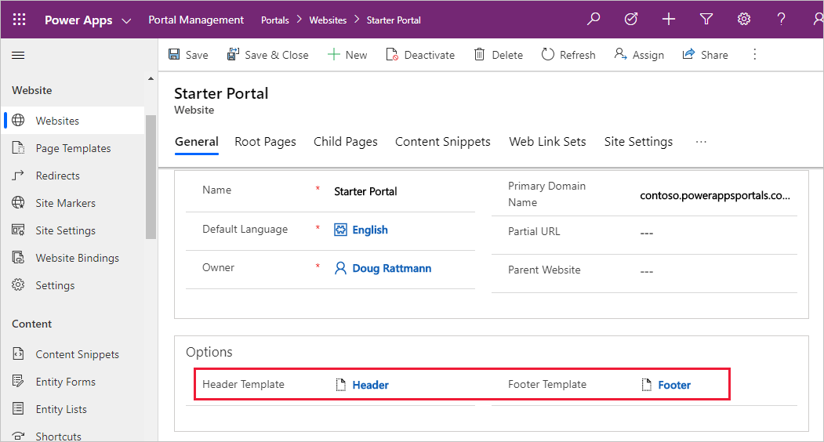
Web templates as website headers and footers
Web templates can be used to override the global header and footer that is used by a Power Apps portal.
Notes:
Web templates can be used to override the global header and footer that is used by a Power Apps portal. To accomplish this task, set the Header Template or Footer Template field of your website to the web template of your choice.
If you override the Header Template field, your selected template assumes responsibility for rendering the primary navigation, sign-in/sign-out links, search interface, and so on, for your site interface elements that are normally handled by the default header template.
[!TIP] If you don't specify a header or a footer template in the Website record, the default content is rendered. To remove, specify a blank template.

Slide 62
Create web templates
Web Template is a simple entity that contains the following attributes:
Name - When a template is included in other content, or extended by other templates, it is referred to by this name.
Source - The source content of the template. It can be static text, an HTML fragment, or most often, a layout by using Liquid.
MIME type - Defines what MIME type that the server will send to the client when the template is rendered. If value is not provided, the value is assumed to be text/html, which is a standard type for HTML pages. It's possible to create a web template that will render specialized content. For example, you can create a web template that will return some Common Data Service data in json format. In this case, the MIME type would be set to application/json.
Notes:
Web Template is a simple entity that contains the following attributes:
Name - When a template is included in other content, or extended by other templates, it is referred to by this name.
Source - The source content of the template. It can be static text, an HTML fragment, or most often, a layout by using Liquid.
MIME type - Defines what MIME type that the server will send to the client when the template is rendered. If value is not provided, the value is assumed to be text/html, which is a standard type for HTML pages. It's possible to create a web template that will render specialized content. For example, you can create a web template that will return some Common Data Service data in json format. In this case, the MIME type would be set to application/json.

Slide 63
Web template management - FetchXML tag
The fetchxml tag allows users to query data from Common Data Service and renders the results in a page.
XML
{% fetchxml varResults %} <!- Fetchxml query --> <fetch> <entity name="account"> <attribute name="name" /> </entity> </fetch> {% endfetchxml %}
{% for account in varResults.results.entities %}
{{ account.name }}<br />
{% endfor %}
Notes:
Liquid implementations within Power Apps portals contain a number of Template tags that help manage templates and promote reusability.
The fetchxml tag allows users to query data from Common Data Service and renders the results in a page.
{% fetchxml varResults %} <!- Fetchxml query --> <fetch> <entity name="account"> <attribute name="name" /> </entity> </fetch> {% endfetchxml %}
The varResults variable will contain the results of the query.
{% for account in varResults.results.entities %} {{ account.name }}<br /> {% endfor %}
[!IMPORTANT] Entity permissions are always applied to the fetchxml tag.

Slide 64
Web template management - Comment tag
With the comment tag, any content within the block will not be rendered, and any Liquid code within will not be run.
XML
This is a {% comment %}very useful {% endcomment %}comment.
Notes:
With the comment tag, any content within the block will not be rendered, and any Liquid code within will not be run. This tag is useful for including extended comments in complex templates and to temporarily comment out blocks of code when you are troubleshooting.
This is a {% comment %}very useful {% endcomment %}comment.
The preceding logic will generate the following result:
This is a comment.

Slide 65
Web template management - Include tag
The include tag includes the contents of one template in another, by name.
XML
{% include 'Breadcrumbs', separator: '>' %}
Notes:
The include tag includes the contents of one template in another, by name. This tag allows for the reuse of common template fragments in multiple places, for example, rendering of social links. The included template will have access to any variables that are defined in the parent template, and it is possible to pass parameters.
{% include 'Breadcrumbs', separator: '>' %}
This logic will include the output that is generated by the Breadcrumbs template that will have a separator variable set to the > symbol.

Slide 66
Web template management - Block tag
By using the block tag, you can define a block within a template, which defines a region that can be optionally overwritten by the templates that extend the current template.
Notes:
By using the block tag, you can define a block within a template, which defines a region that can be optionally overwritten by the templates that extend the current template.

Slide 67
Web template management - Extend tag
When used in conjunction with the block tag, the extend tag provides template inheritance.
Base template
XML
<div> Hello {% block content %}default content{% endblock %} </div>
Notes:
Extend tag
When used in conjunction with the block tag, the extend tag provides template inheritance. This tag allows multiple templates to use a shared layout while overriding specific areas of the parent layout. When extends is used, it must be the first content in the template and can only be followed by one or more block tags.
Base template
The base template logic is as follows:
XML
<div> Hello {% block content %}default content{% endblock %} </div>

Slide 68
Child template
XML
{% extends 'Base Template' %}
{% block content %}Power Apps portals{% endblock%}
HTML
<div>
Hello
Power Apps portals
</div>
Notes:
Child template
The child template logic is as follows:
XML
{% extends 'Base Template' %} {% block content %}Power Apps portals{% endblock%} The child template will generate the following output:
HTML
<div> Hello Power Apps portals </div>
The typical use of the extend and block tags is to separate layout and content templates. Parent or base templates usually define broad page layout, for example, if it's a single column or a two-column page. Child templates that extend the base can only define the content of the blocks as specified by the parent.
For a comprehensive Liquid code sample that demonstrates template inheritance with block/extend and include tags, see Create a custom page template.

Slide 69
Web templates best practices
Choose descriptive names for your templates because they will be referenced or included as part of other templates.
Break down the page layout and separate layout from content. These layouts will be candidates for extendable templates.
Look out for repeatable and reusable fragments; these fragments can be defined as sub templates and will use the include tag.
Use the include tag to help reuse layout and commonly used JavaScript fragments. Make your JavaScript templates "smart" by using parameters that are available in the include tag. These fragments will be inserted inline.
Move larger, reusable blocks of JavaScript to separate files and insert them as a reference instead. The client's browser will load them separately and they can be cached. In addition, externally loaded scripts can be minified, which will result in better performance.
Find parts of the page that need to be translated for multilingual implementation. Define these pages as either page content or content snippets.
Identify editable fragments. Determine which parts of the webpage where you want users to be responsible for content management and maintenance.
Notes:
The following steps will help you improve template structure and make the web templates more manageable:
Choose descriptive names for your templates because they will be referenced or included as part of other templates.
Break down the page layout and separate layout from content. These layouts will be candidates for extendable templates.
Look out for repeatable and reusable fragments; these fragments can be defined as sub templates and will use the include tag.
Use the include tag to help reuse layout and commonly used JavaScript fragments. Make your JavaScript templates "smart" by using parameters that are available in the include tag. These fragments will be inserted inline.
Move larger, reusable blocks of JavaScript to separate files and insert them as a reference instead. The client's browser will load them separately and they can be cached. In addition, externally loaded scripts can be minified, which will result in better performance.
Find parts of the page that need to be translated for multilingual implementation. Define these pages as either page content or content snippets.
Identify editable fragments. Determine which parts of the webpage where you want users to be responsible for content management and maintenance.

Slide 70
Web templates best practices
Be generous with the layout when you are writing a template, but avoid excessive blank lines by using hyphens in your tags
Use the tag to describe complex parts of the template.
Study templates that are already deployed with the starter portal and look for Liquid techniques in Create advanced templates for portals.
XML
{%- if username -%} Hello, {{ user.firstname}} {%- endif -%}
Notes:
Be generous with the layout when you are writing a template, but avoid excessive blank lines by using hyphens in your tags, for example:
{%- if username -%} Hello, {{ user.firstname}}{%- endif -%}
Use the comments tag to describe complex parts of the template.
Study templates that are already deployed with the starter portal and look for Liquid techniques in Create advanced templates for portals.
{%- if username -%} Hello, {{ user.firstname}} {%- endif -%}
Numerous ready-to-use Liquid templates are installed when you provision a starter portal: Built-in web templates. Their names are fixed, and the templates are not available for editing.
For more information, see Work with Liquid templates.

Slide 71
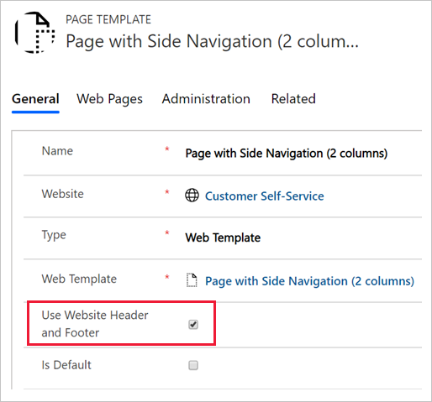
Web templates as API
The Page Template entity has a setting that specifies whether the page should use the common website header and footer templates when the web template is used.
Notes:
The Page Template entity has a setting that specifies whether the page should use the common website header and footer templates when the web template is used.
When the website header and footer are not used, the template assumes responsibility for generating the entire page output. In the case when you're rendering HTML, this output includes everything from the doctype to the root <html> tags, and everything in between. This approach could be useful in a couple different scenarios:
Special purpose pages need to appear different from the rest of the portal, for example, marketing campaign landing pages.
The web template generates non-HTML content, returning data in XML, json, or other formats.

Slide 72
Web templates as API
twig
JSON
{% entityview logical_name:'account', name:'Active Accounts' %}
[
{% for acc in entityview.records -%}
{
"name": "{{ acc.name }}",
"phone": "{{ acc.telephone1 }}"
}{% unless forloop.last %},{% endunless %}
{% endfor -%}
]
{% endentityview %}
[
{
"name": "A Datum Corporation",
"phone": "425-555-0182"
},
{
"name": "A Datum Fabrication",
"phone": "303-555-0134"
},
{
"name": "A Datum Integration",
"phone": "512-555-0163"
},
{
"name": "A. Datum",
"phone": "+86-23-4444-0100"
},
{
"name": "Adventure Works",
"phone": "+27-264-1234567"
}
]
Notes:
For example, you can create a web template that returns a list of accounts, or any other data that the current user has access to, in json format.
Note
In this example, instead of the entityview tag, you can use a FetchXML query inside the fetchxml tag. Using inline FetchXML adds some flexibility to the query. The query can be built dynamically by using template parameters or even a request object that contains query string parameters of a current HTTP page request.
This template would be used without a header and footer, with the MIME type set to application/json. The output would be similar to the following example:
The page that uses this web template wouldn't be used by people who are in a browser; instead, it will be called from JavaScript code, effectively defining an API endpoint for your solution. JavaScript on another page would be able to load and render this data as required.
Authorization will be in place, and accessing Microsoft Dataverse data by using this "headless" template is no different than if the output was rendered as HTML. The calling page would typically require user authentication prior to calling the endpoint.

Slide 73
Exercise: Create an extendable web template
Follow the exercise in the student manual
Notes:
Link: https://docs.microsoft.com/en-us/learn/modules/portal-custom-web/4-exercise

Slide 74
Closing slide

